Slide 1
Rocky planets
Gas giants
Internal Structure
Atmospheres (a tiny bit)
Notes:
Great Kurzgesagt video on the Solar System: https://www.youtube.com/watch?v=KsF_hdjWJjo

Slide 2
The Planets

Slide 3
Recap
What lies in-between Mars and Jupiter?
Where is the edge of the solar system?
What happened when Uranus and Neptune swapped positions during the formation of the SS?

Slide 4
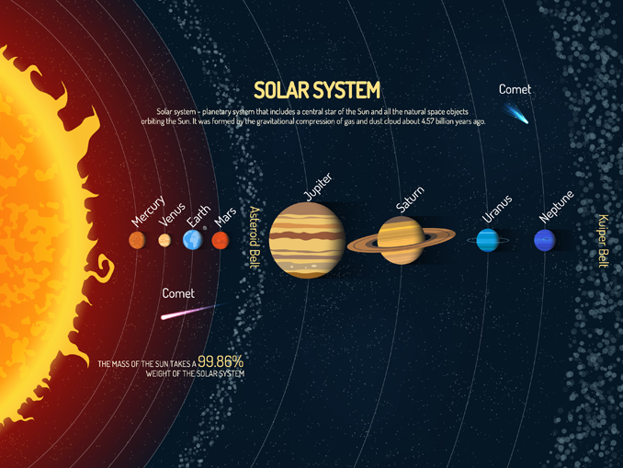
Not to Scale!
EARTHHOW
Notes:
Diagram of the SS by EarthHow: https://earthhow.com/solar-system-facts/
Oort cloud not shown!
Formed 4.571 billion years ago
Earth ~ 4.543 billion years

Slide 5
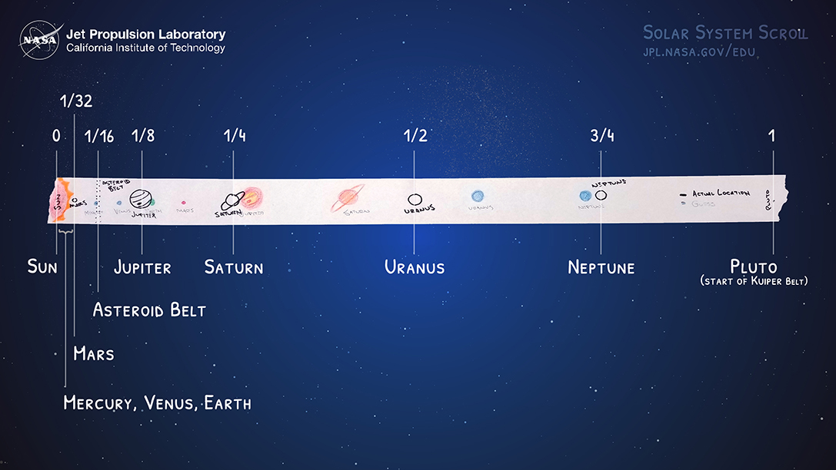
NASA/JPL
Notes:
Actual positions! – we did this practical last lesson

Slide 6
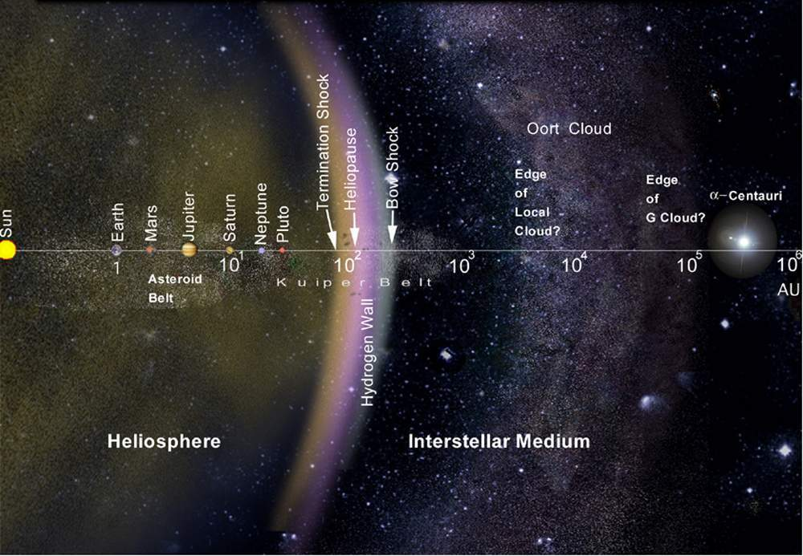
Solar System
1 AU = 1.495978707×10¹¹ m
NASA
Notes:
Image from an article about Voyager: https://voyager.jpl.nasa.gov/mission/did-you-know/
The Oort cloud extends to 1/5 the distance to the nearest star!
Notice the log scale
Termination shock – particles slow to less than the speed of sound
Heliopause – pressure from outside is the same as from the solar wind
Theoretical wall of Hydrogen just after the heliopause
Little to no bow shock around our Sun.
Oort cloud marks edge of gravitational influence of the Sun. All of that is embedded in the Local Cloud next to the G cloud which contains alpha Centauri. Outside the Oort cloud is interstellar space.

Slide 7
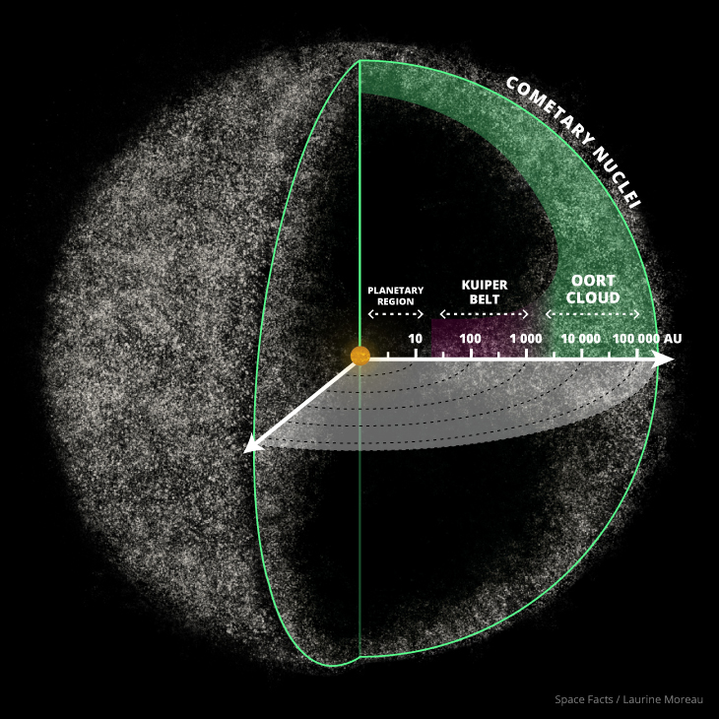
Solar System
Space Facts/Laurine Moreau
Notes:
Zoomed out to see the spherical shape of the cloud
Hard to visualise large numbers try making as many tallies on a piece of paper that you can in 60 s. How long would it take us to make a million tallies?
These are huge numbers!
Inner Oort cloud is disk shaped after Kuiper Belt and the outer cloud is spherical. Source of long period comets!

Slide 8
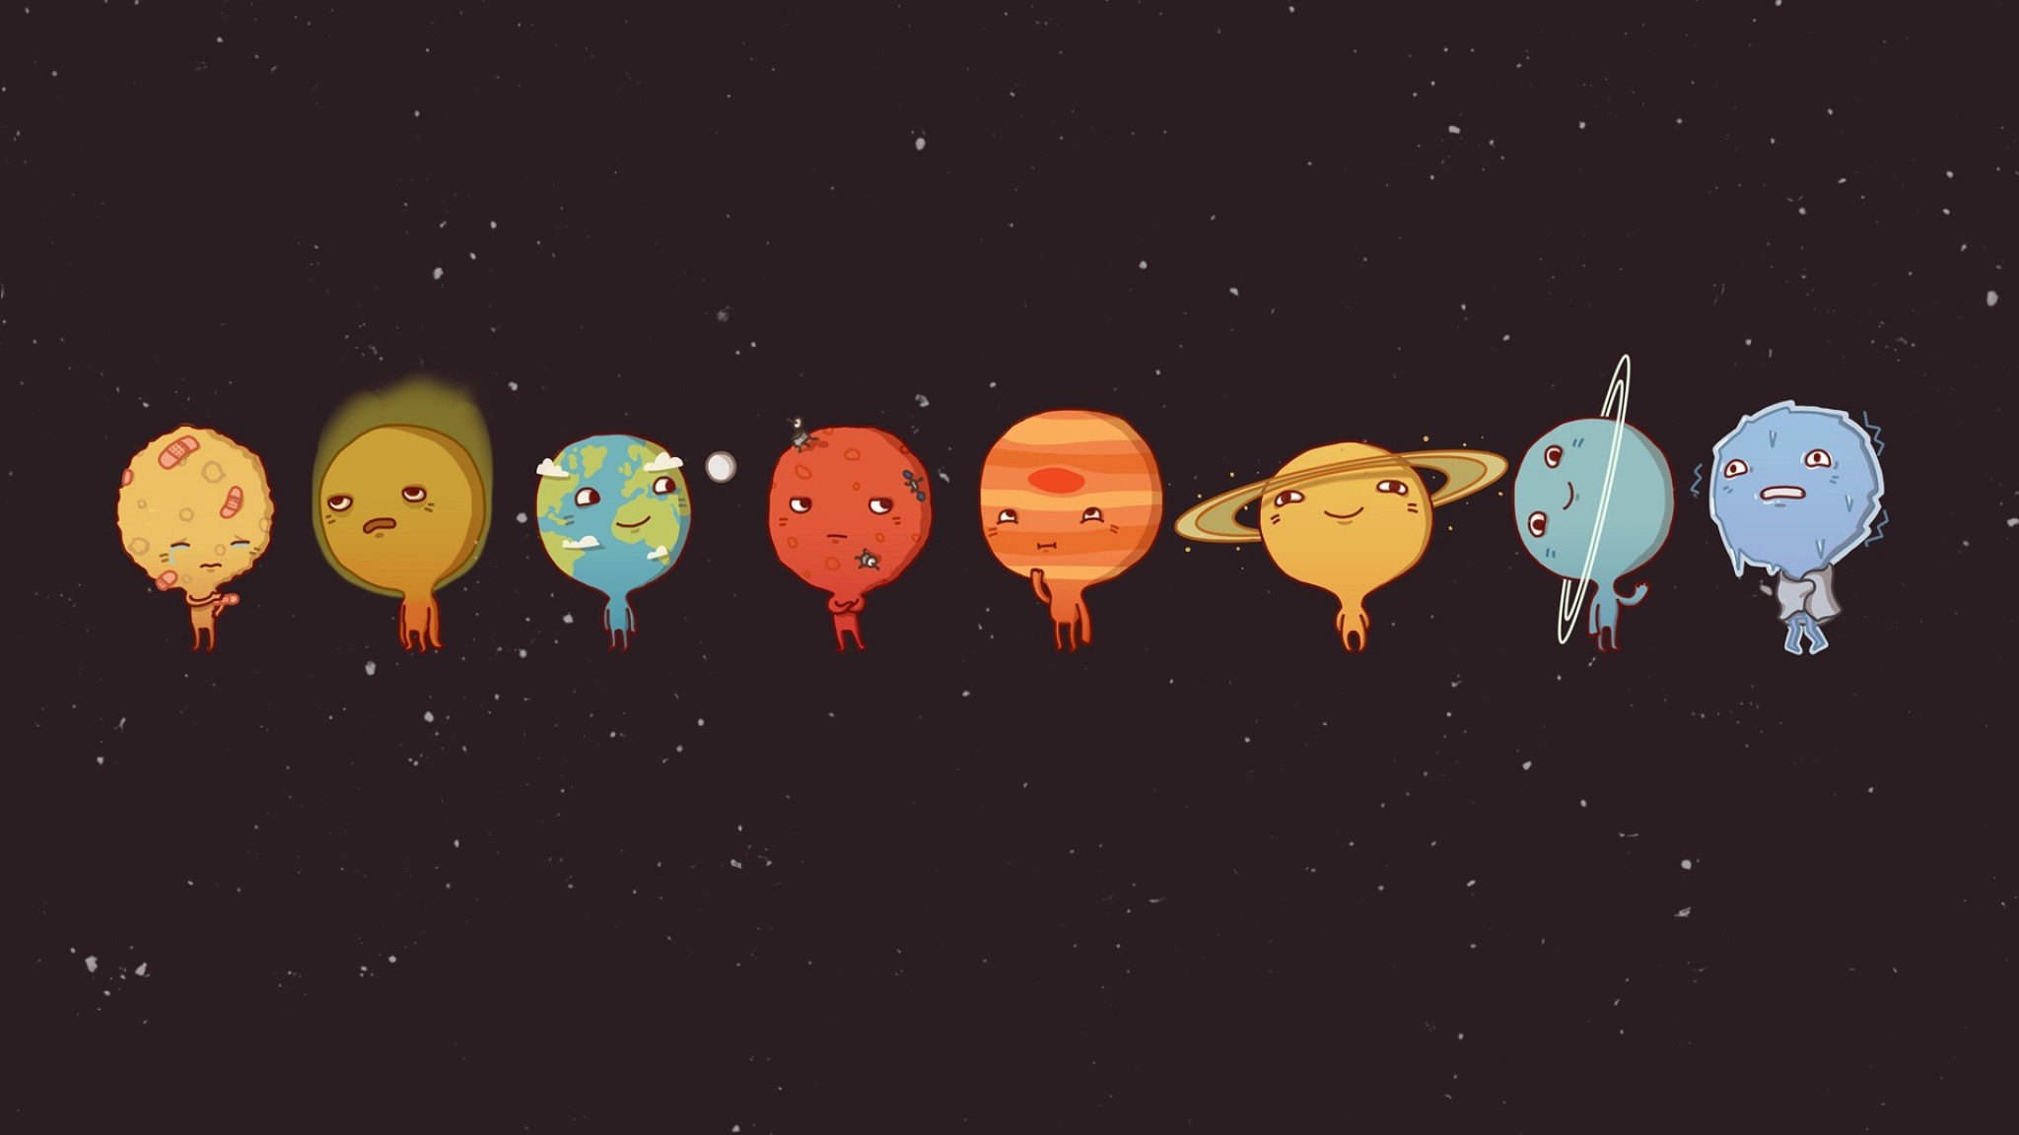
There are 8 planets!
Notes:
Image Author Unknown
Can you name the planets in order?

Slide 9
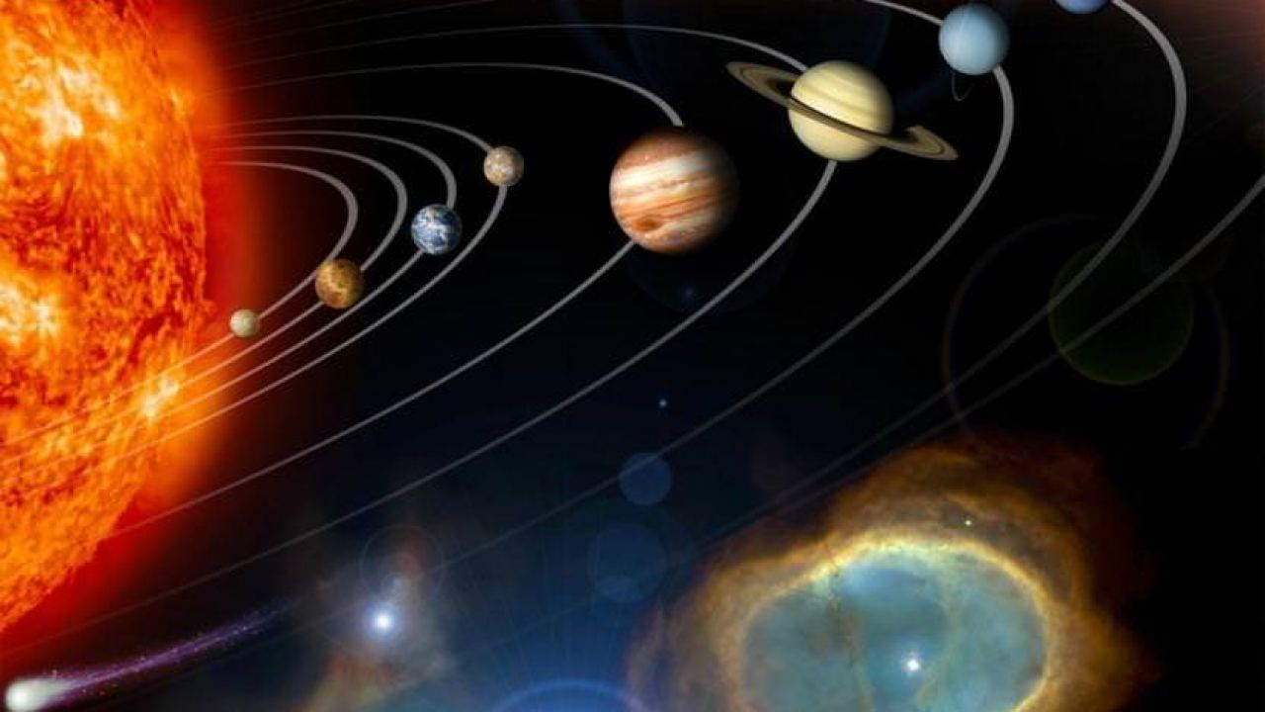
Mercury | My
Venus | Vicious
Earth | Earthworm
Mars | Might
Jupiter | Just
Saturn | Swallow
Uranus | Us
Neptune | Now
Linda Chisholm
Notes:
Easy way to remember the order.

Slide 10
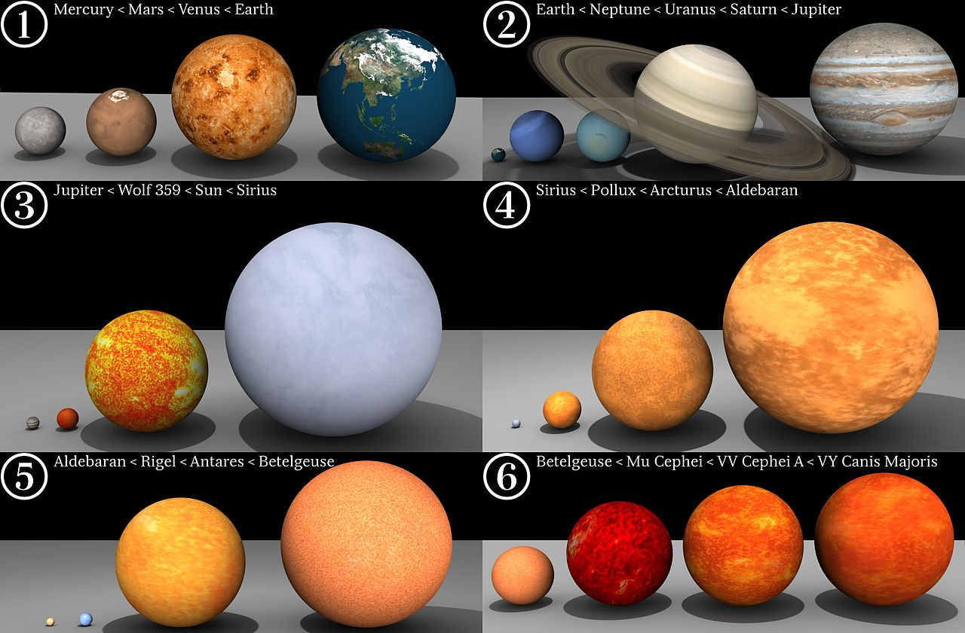
Dave Jarvis
Notes:
Planets to scale with stars for comparison.

Slide 11
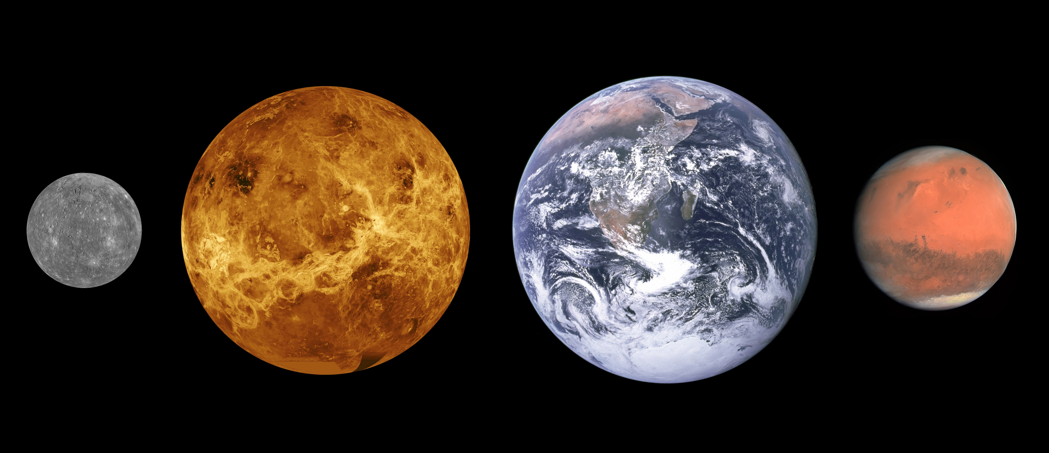
The Rocky Planets
Notes:
Mercury image: NASA/JHUAPL Venus image: NASA Earth image: NASA/Apollo 17 crew Mars image: ESA/MPS/UPD/LAM/IAA/RSSD/INTA/UPM/DASP/IDA
Scales are roughly correct, distances between them not so much.

Slide 12
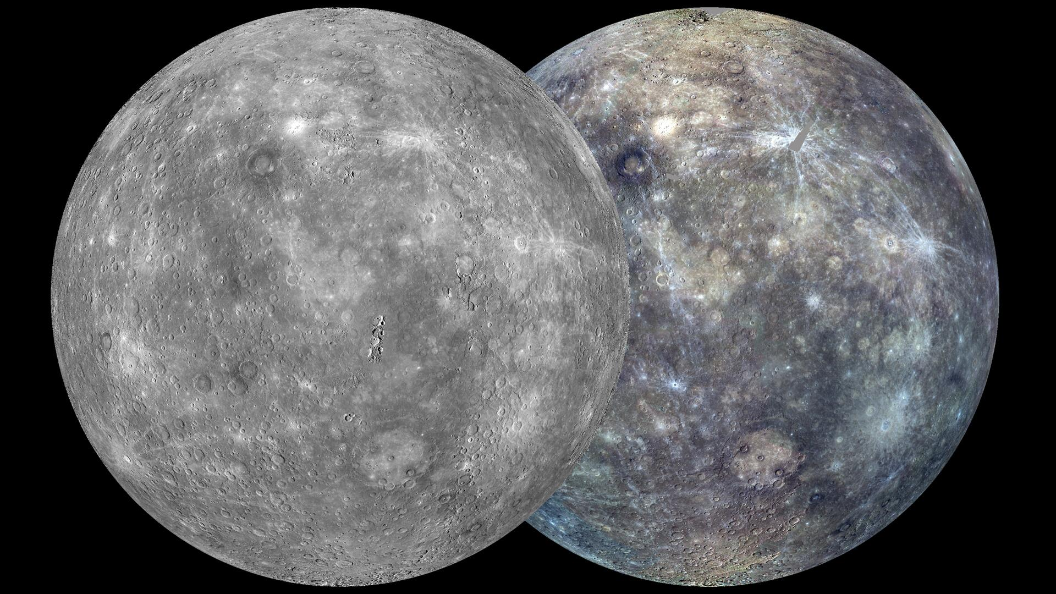
Mercury
NASA/Johns Hopkins University Applied Physics Laboratory/Carnegie Institution of Washington
Notes:
Original Caption Released with Image: The view shown here is similar to an earlier one, posted in October 2011, but now the coverage is more complete. The globe on the left was created from the MDIS monochrome surface morphology base map campaign. The globe on the right was produced from the MDIS color base map campaign. Each map is composed of thousands of images, and the color view was created by using 3 of the 8 color filters acquired. (1000, 750, and 430 nm wavelengths are displayed in red, green, and blue, respectively.) On March 8, 2013, these global maps will be publicly released at full resolution by NASA's Planetary Data System.
Instrument: Mercury Dual Imaging System (MDIS) Center Latitude: 0° Center Longitude: 75° E Scale: Mercury's diameter is 4880 kilometers (3030 miles). Map Projection: orthographic
PIA16858

Slide 13
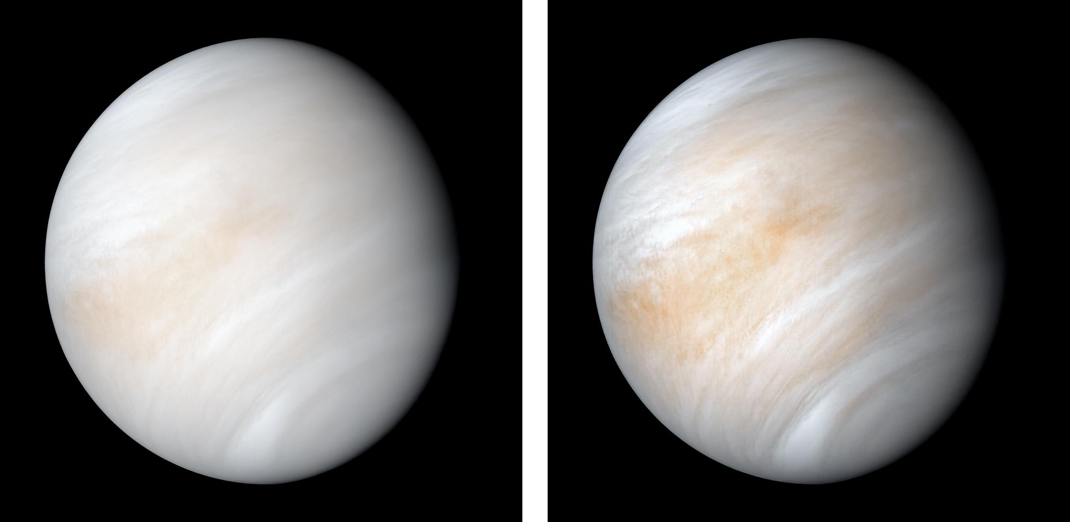
Venus
NASA/JPL-Caltech
Notes:
PIA23791: Venus from Mariner 10
Right is enhanced colour
Images taken on 7 and 8th of Feb 1974.

Slide 14
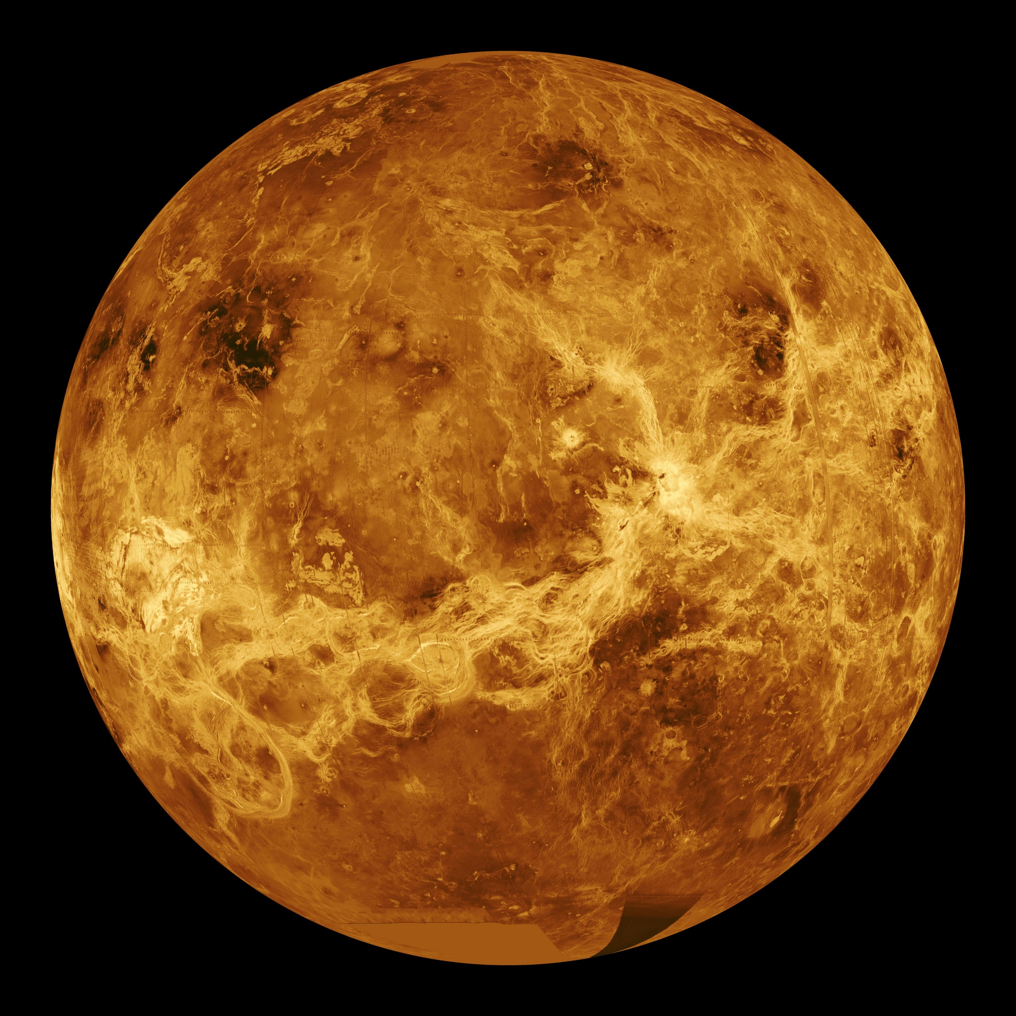
Venus
NASA/JPL
Notes:
PIA00104: Venus - Computer Simulated Global View Centered at 180 Degrees East Longitude
Original Caption Released with Image: This global view of the surface of Venus is centered at 180 degrees east longitude. Magellan synthetic aperture radar mosaics from the first cycle of Magellan mapping are mapped onto a computer-simulated globe to create this image. Data gaps are filled with Pioneer Venus Orbiter data, or a constant mid-range value. Simulated color is used to enhance small-scale structure. The simulated hues are based on color images recorded by the Soviet Venera 13 and 14 spacecraft. The image was produced by the Solar System Visualization project and the Magellan science team at the JPL Multimission Image Processing Laboratory and is a single frame from a video released at the October 29, 1991, JPL news conference.

Slide 15
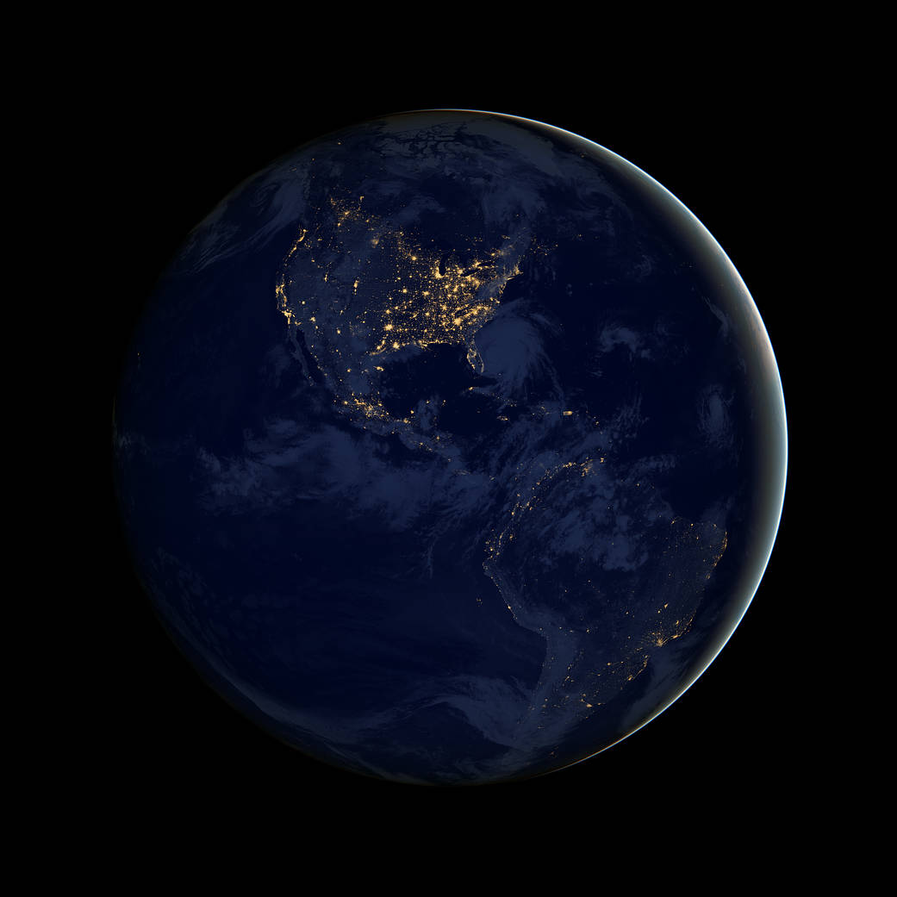
Earth
NASA
Notes:
https://www.nasa.gov/image-feature/brilliance-at-night-the-americas-in-darkness
This image's striking nighttime view was made possible by Suomi’s “day-night band” of the Visible Infrared Imaging Radiometer Suite. VIIRS detects light in a range of wavelengths from green to near-infrared and uses filtering techniques to observe dim signals such as city lights, gas flares, auroras, wildfires and reflected moonlight. In this case, auroras, fires and other stray light have been removed to emphasize the city lights.

Slide 16
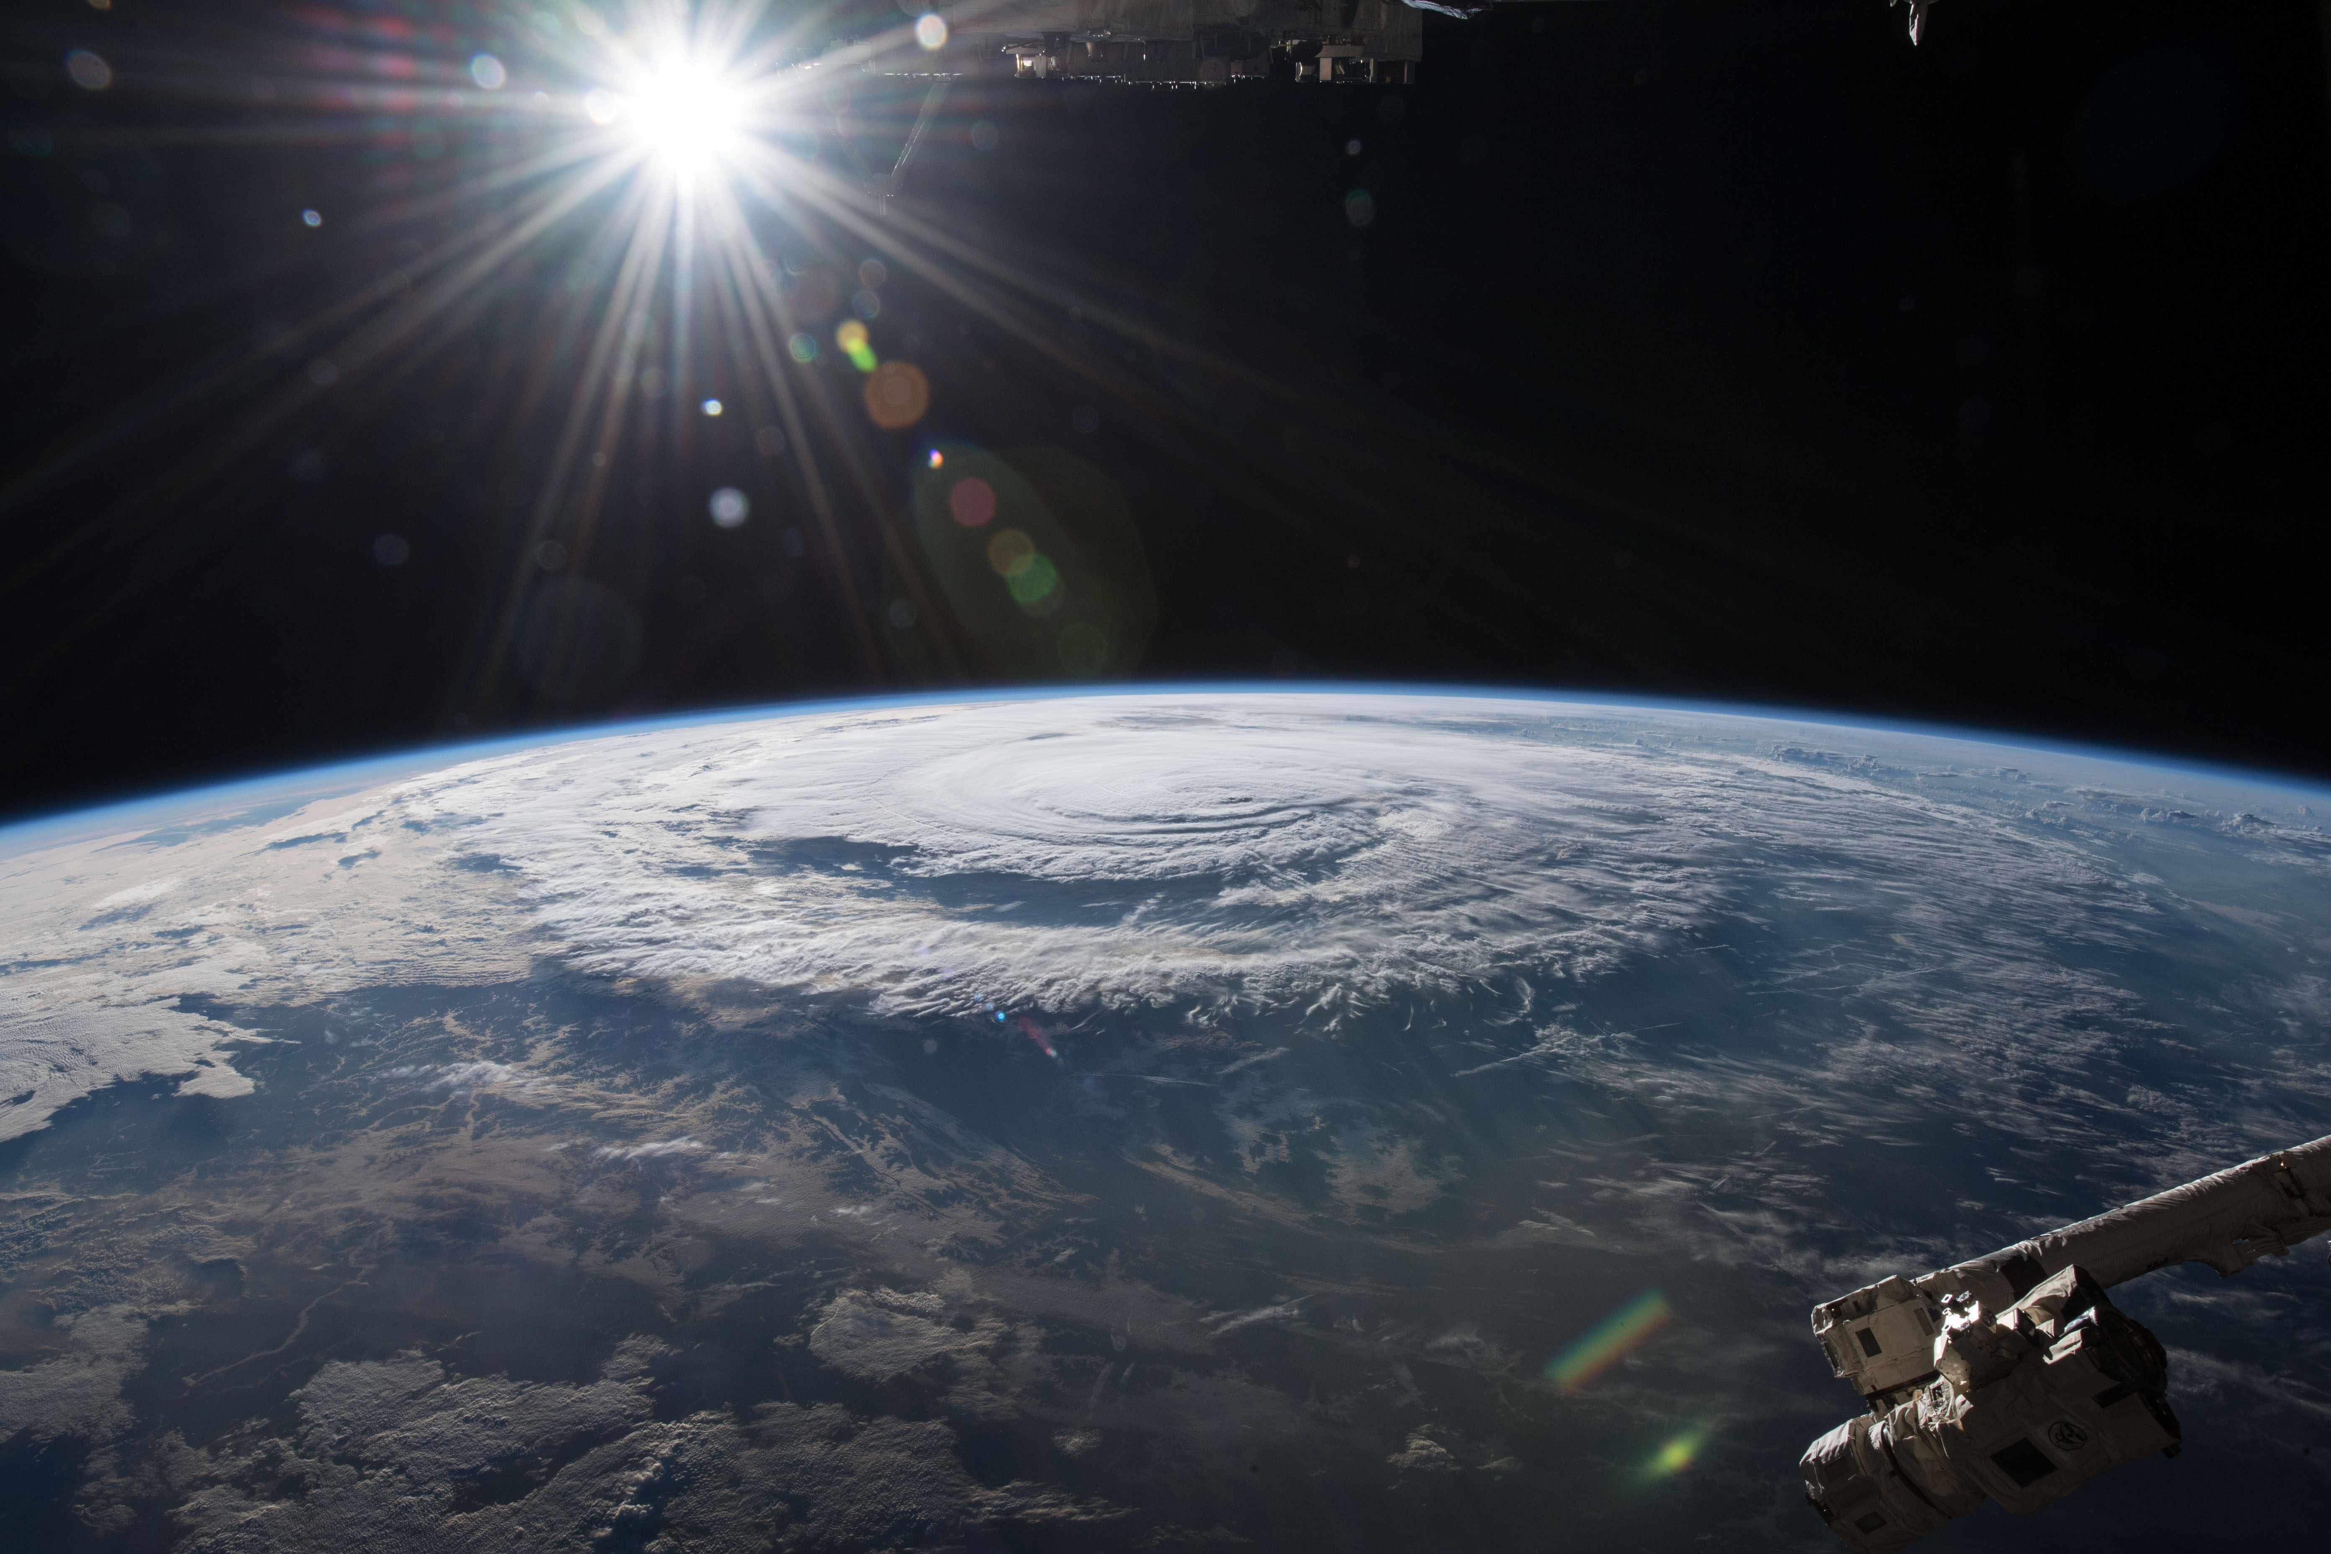
NASA
Notes:
https://www.nasa.gov/image-feature/hurricane-florence-as-it-was-making-landfall
iss056e162819 (Sept. 14, 2018) --- Hurricane Florence is pictured from the International Space Station as a category 1 storm as it was making landfall near Wrightsville Beach, North Carolina.

Slide 17
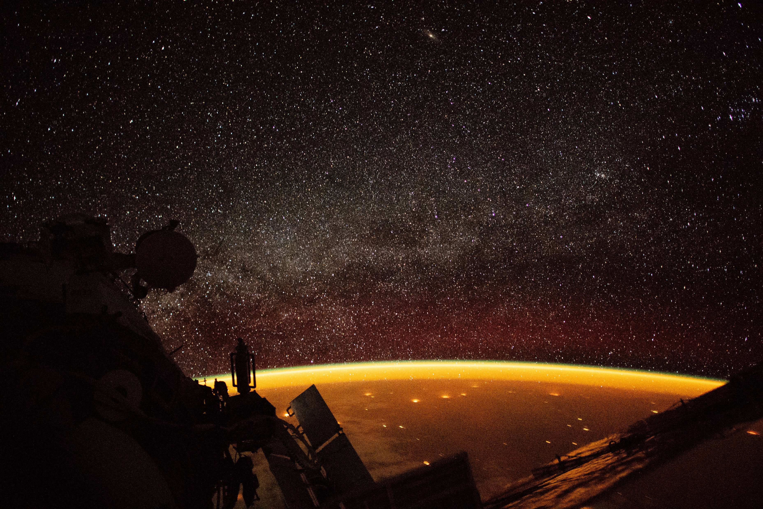
NASA
Notes:
https://www.nasa.gov/image-feature/earth-enveloped-in-airglow
On October 7, 2018, an astronaut aboard the International Space Station (ISS) shot this photograph while orbiting at an altitude of more than 250 miles over Australia.
The orange hue enveloping Earth is known as airglow—diffuse bands of light that stretch 50 to 400 miles into our atmosphere. The phenomenon typically occurs when molecules (mostly nitrogen and oxygen) are energized by ultraviolet (UV) radiation from sunlight. To release that energy, atoms in the lower atmosphere bump into each other and lose energy in the collision. The result is colorful airglow.

Slide 18
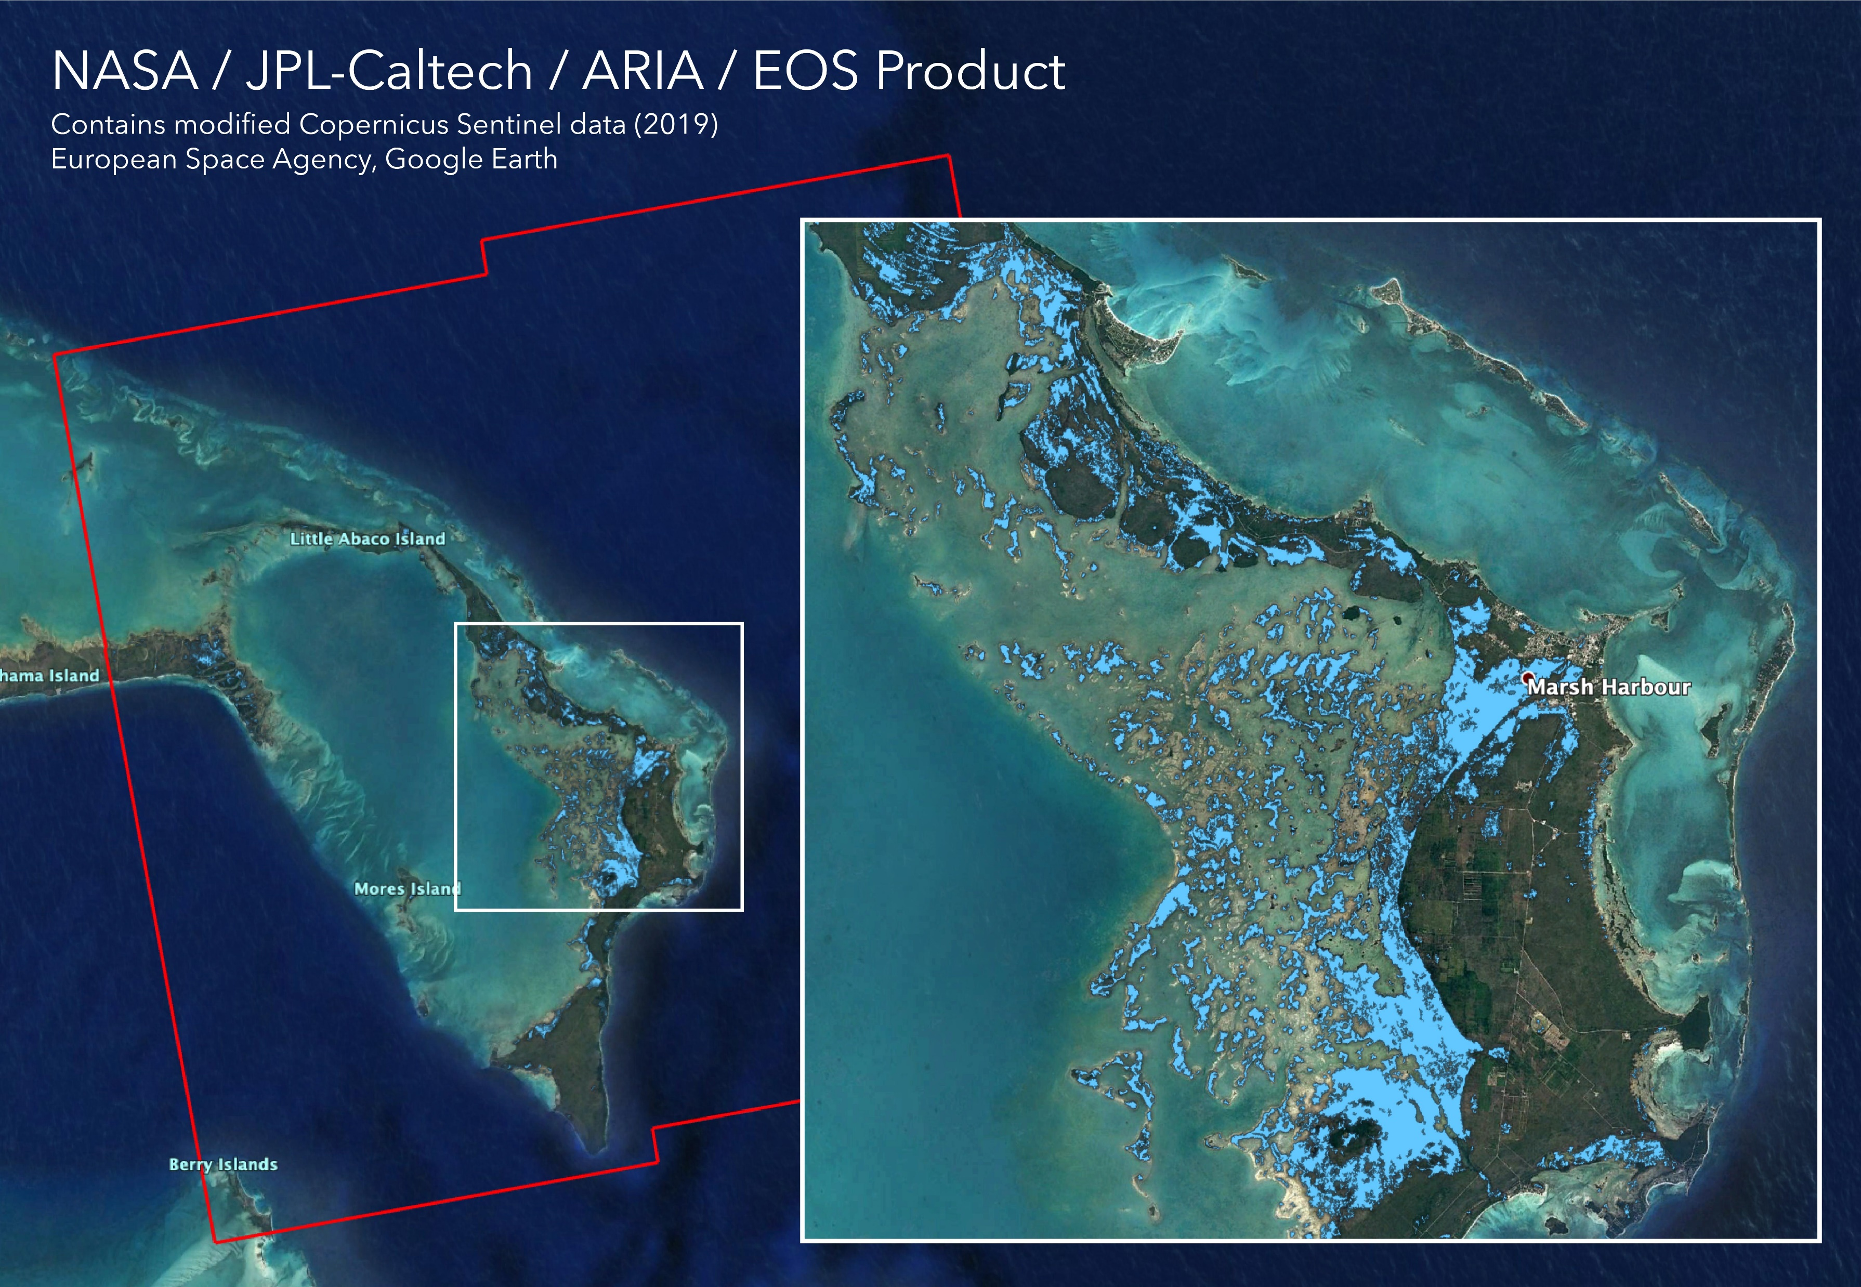
NASA/JPL-Caltech, ESA, EOS
Notes:
https://photojournal.jpl.nasa.gov/catalog/PIA23360
PIA23360: Flooding from Dorian Seen from Space
Flood map depicting areas of the Bahamas that are likely flooded (shown by light blue pixels) as a result of Hurricane Dorian. The map was derived from synthetic aperture radar (SAR) data acquired on Sept. 2, 2019, by the European Union's Copernicus Sentinel-1 satellites operated by the European Space Agency (ESA). The map covers an area of 109 miles by 106 miles (176 kilometers by 170 kilometers) shown by the large red polygon. Each pixel measures about 32 yards (30 meters) across.

Slide 19
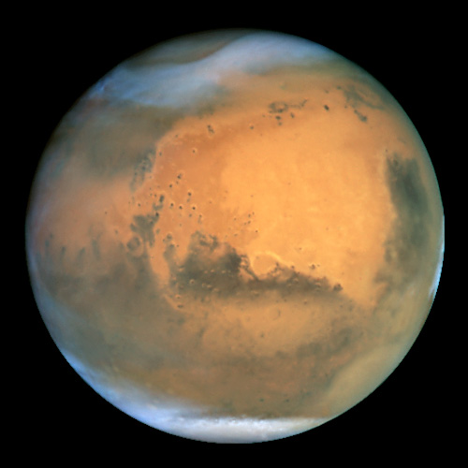
Mars
NASA/ESA and The Hubble Heritage Team STScI/AURA
Notes:
https://www.spacetelescope.org/images/opo0124a/
Frosty white water ice clouds and swirling orange dust storms above a vivid rusty landscape reveal Mars as a dynamic planet in this sharpest view ever obtained by an Earth-based telescope. The Earth-orbiting Hubble telescope snapped this picture on June 26, when Mars was approximately 43 million miles (68 million km) from Earth - its closest approach to our planet since 1988. Hubble can see details as small as 10 miles (16 km) across. Especially striking is the large amount of seasonal dust storm activity seen in this image. One large storm system is churning high above the northern polar cap [top of image], and a smaller dust storm cloud can be seen nearby. Another large duststorm is spilling out of the giant Hellas impact basin in the Southern Hemisphere [lower right].

Slide 20
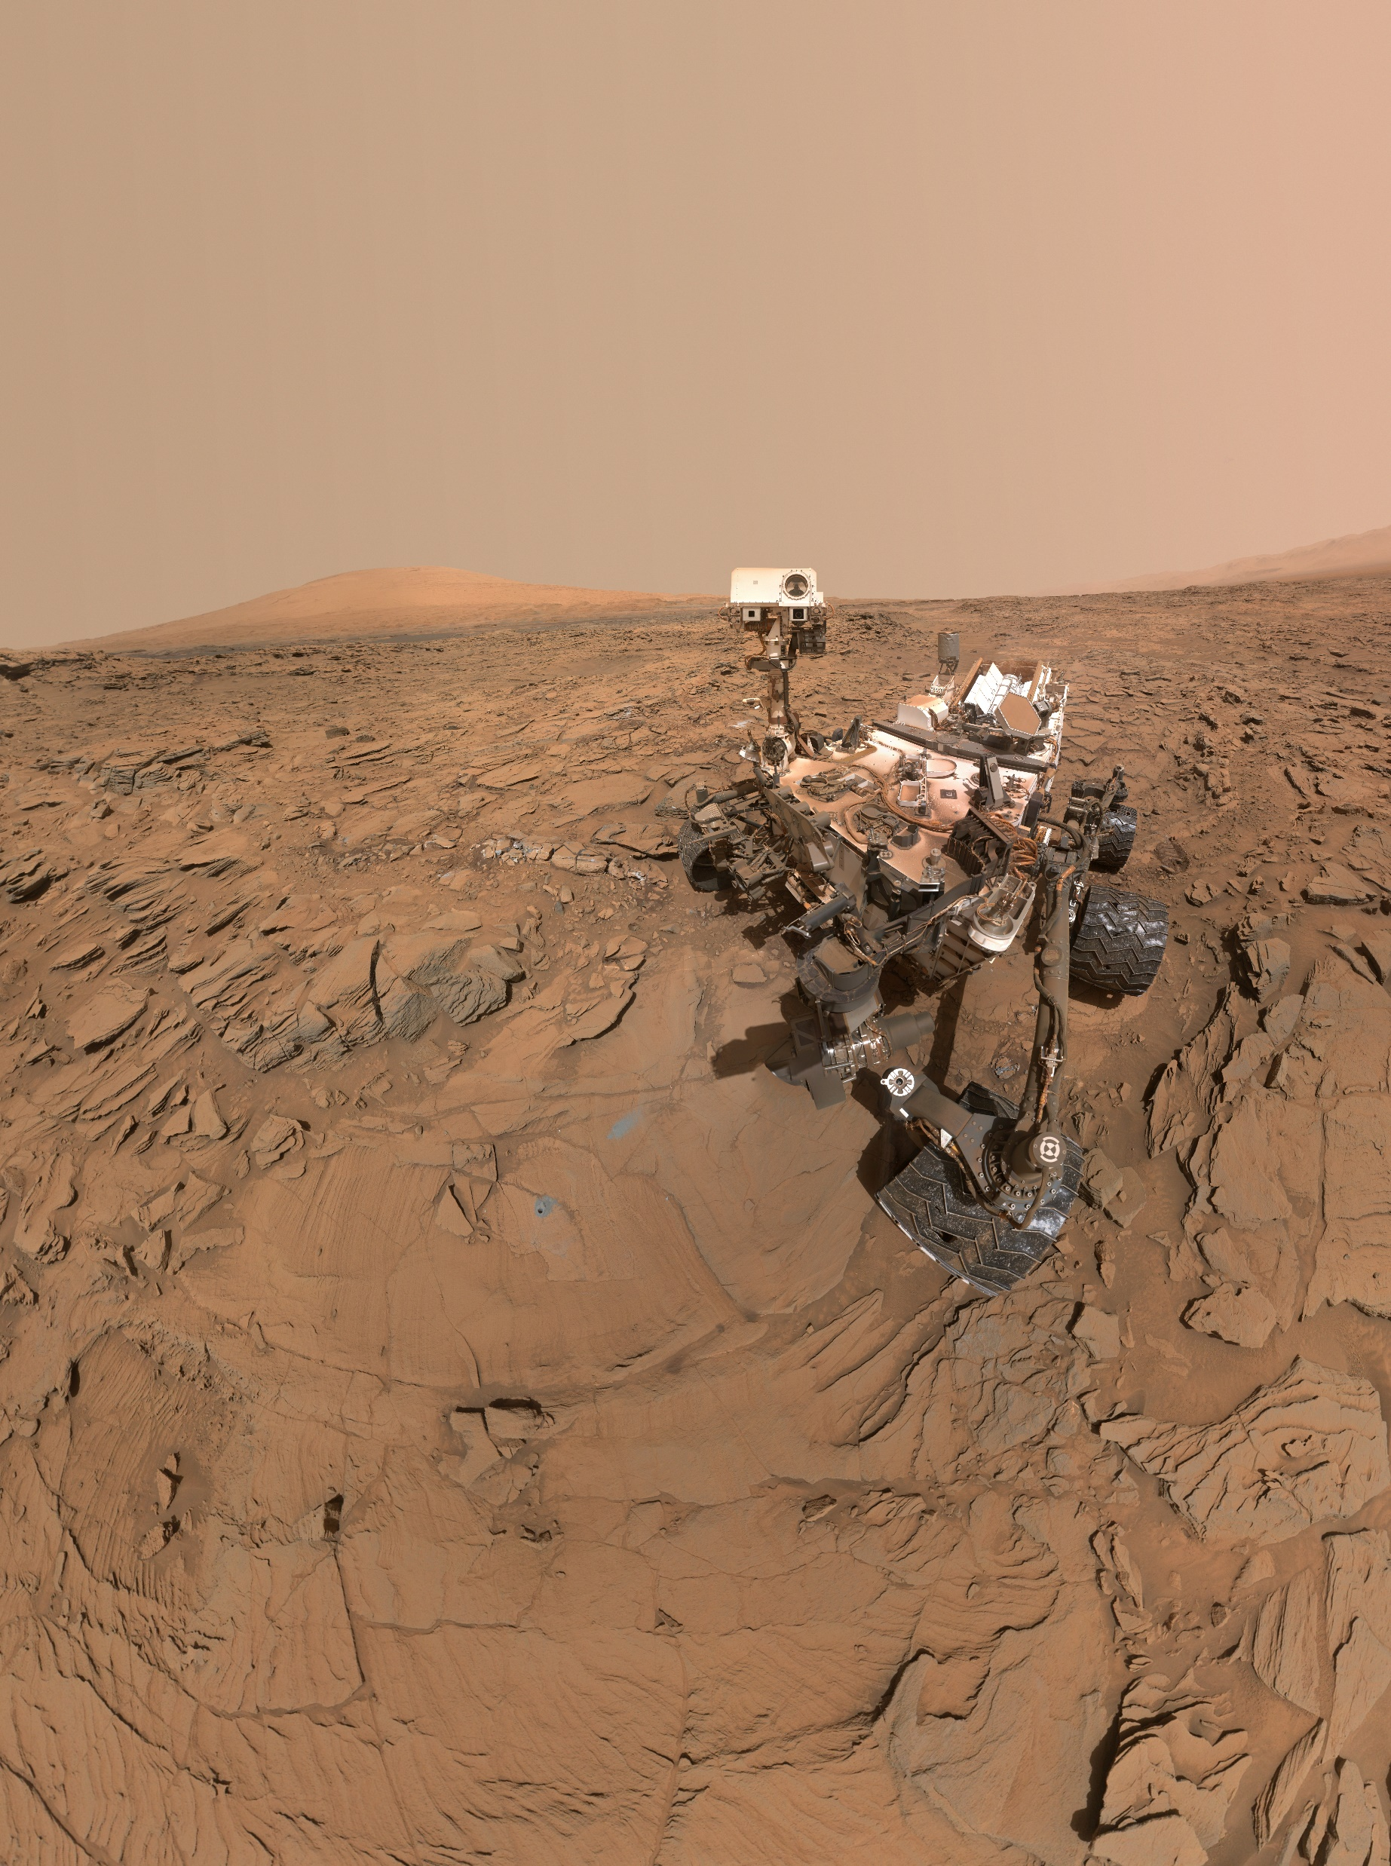
NASA/JPL-Caltech/MSSS
Notes:
Curiosity Self-Portrait at 'Okoruso' Drill Hole
https://mars.nasa.gov/resources/7856/curiosity-self-portrait-at-okoruso-drill-hole/?site=msl

Slide 21
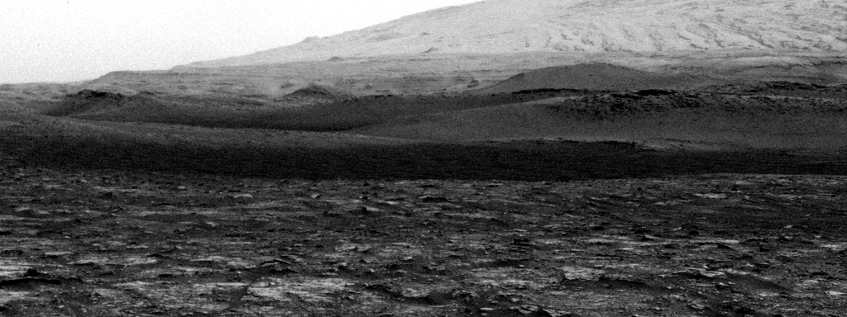
NASA/JPL-Caltech/SSI
Notes:
Curiosity Spots a Dust Devil in the Hills
https://mars.nasa.gov/resources/25235/curiosity-spots-a-dust-devil-in-the-hills/?site=msl

Slide 22
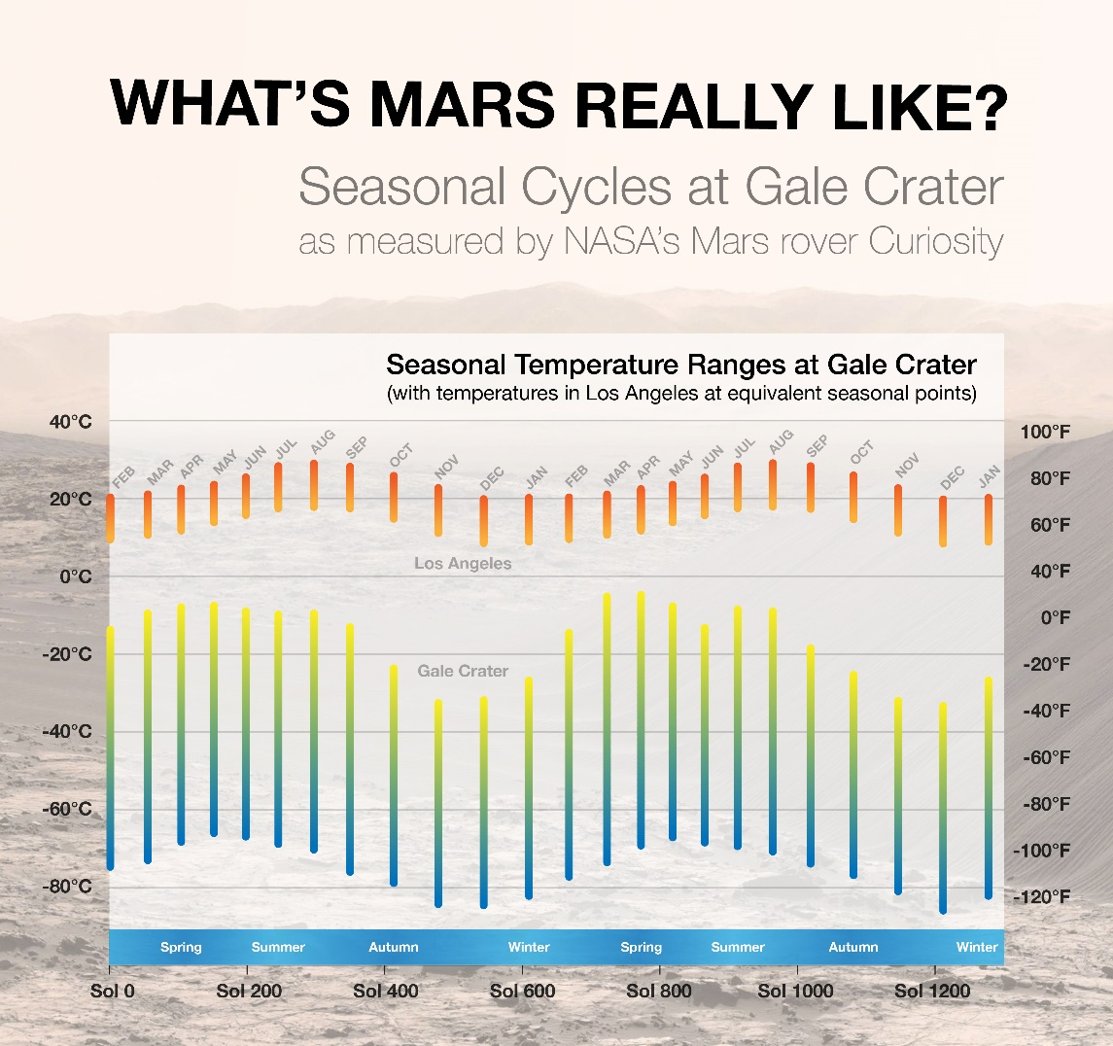
NASA/JPL-Caltech/CAB(CSIC-INTA)
Notes:
https://mars.nasa.gov/resources/7818/seasonal-cycles-in-curiositys-first-two-martian-years/?site=msl

Slide 23
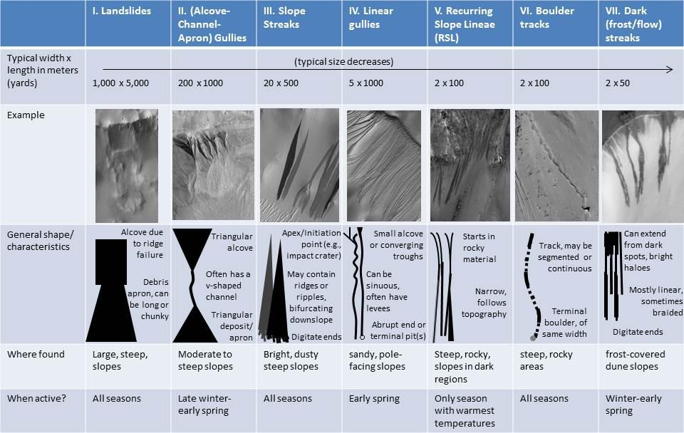
NASA/JPL-Caltech/ASA/MSSS/UA
Notes:
Martian Features Formed When Material Moves Downslope
As on the Earth, many processes can move material down a Martian slope. This graphic compares seven different types of features observed on Mars that appear to result from material flowing or sliding or rolling down slopes.
Processes that explain one type of downslope feature may be irrelevant to another type. Some processes depend on the presence of a fluid, some are driven by seasonal changes in the environment, and others occur randomly when gravity is able to pull down unstable slope material.
These different processes can generate a wide range of feature shapes, though sometimes different processes can yield similar-looking results. Thus, to figure out how a feature may have formed, more must be considered than its shape. For example, researchers examining images from Mars orbiters have found differences in 1. the season when the features are formed or are active (e.g., the features called "recurring slope lineae" or RSLs appear during late spring and summer, but linear gullies are active only during early spring); 2. the features' sizes (e.g., slope streaks can extend for miles or kilometers, but dark frost streaks on dunes extend only up to 100 yards, or meters); and 3. the types of terrain on which a feature is found (e.g., gullies with an alcove-channel-apron shape are found both on rocky slopes and on sandy slopes, but linear gullies are only found on sandy slopes; dark frost streaks are formed on frozen dune slopes, but RSLs are formed on dark, warm slopes).
https://photojournal.jpl.nasa.gov/beta/catalog/PIA17079

Slide 24
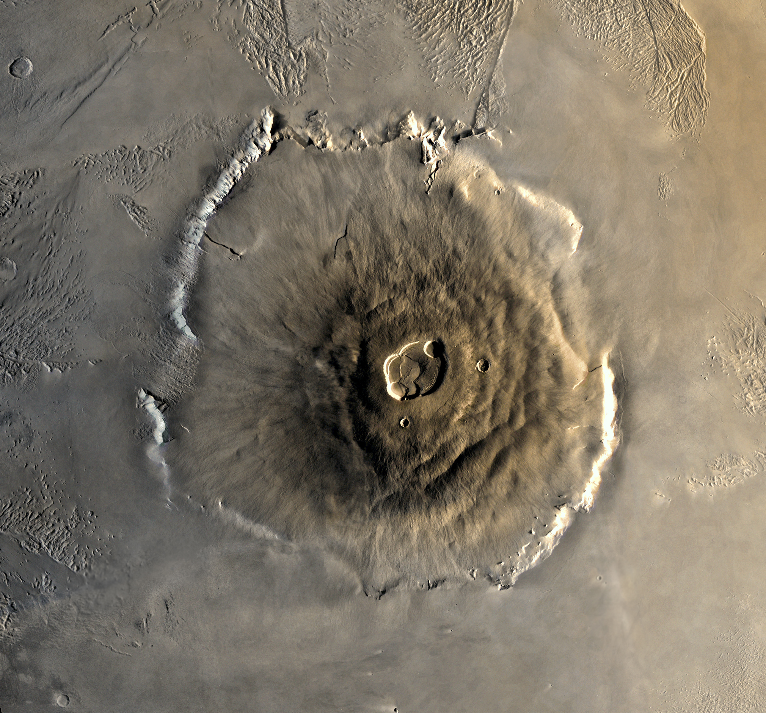
NASA/Seddon - wikimedia
Notes:
This image is a mosaic of Olympus Mons. The mosaic was created with the medium-resolution black and white MDIM combined with a low resolution color image mosaic acquired on the 735 orbit of Viking 1 on June 22, 1978. The central edifice of Olympus Mons has a summit caldera 24 km above the surrounding plains. Surrounding the volcano is an outward-facing scarp 550 km in diameter and several kilometres high. Beyond the scarp is a moat filled with lava, most likely derived from Olympus Mons. Farther out is an aureole of characteristically grooved terrain, just visible at the top of the frame. Image Processing by Jody Swann/Tammy Becker/Alfred McEwen, using the PICS (Planetary Image Cartography System) image processing system developed at the U.S. Geological Survey in Flagstaff, Arizona.

Slide 25
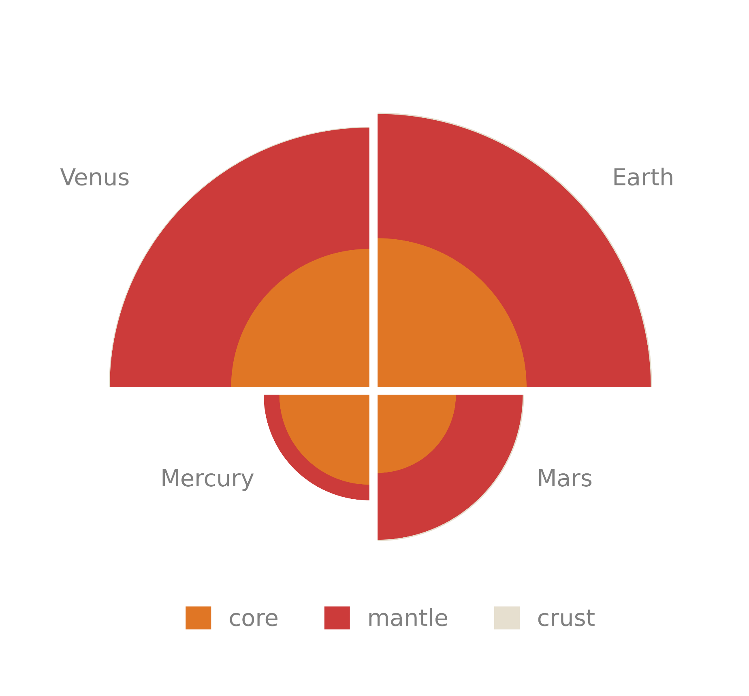

Slide 26
Quick Quiz
Why are the first four planets called the ‘Rocky’ planets?
Mercury’s surface is covered in what?
What landforms provide evidence for water on Mars?

Slide 27
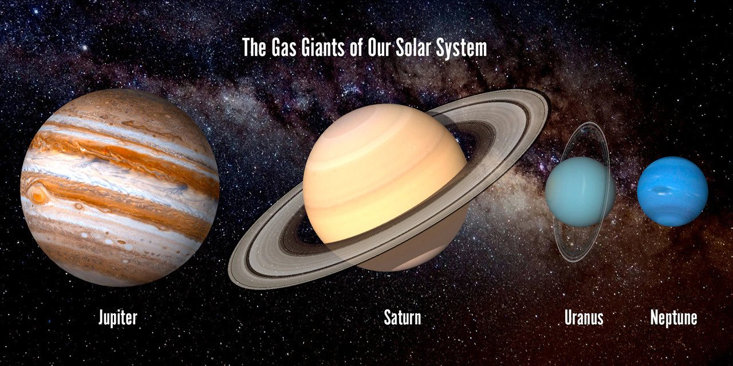
Notes:
Author Unknown

Slide 28
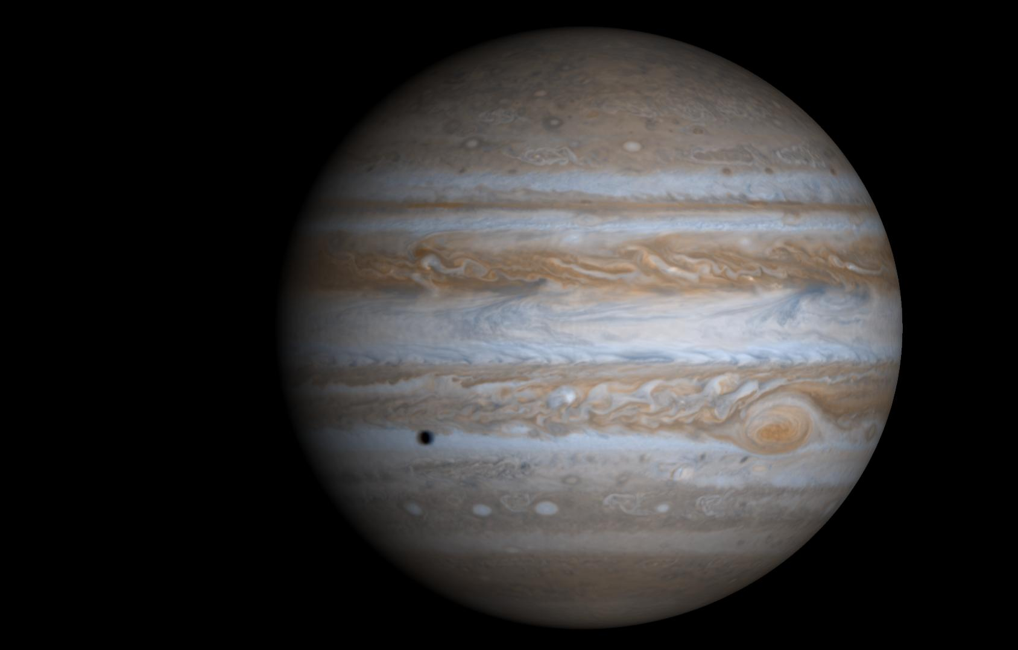
Jupiter
JPL/NASA
Notes:
Cassini Comp. with Europa shadow Molecular hydrogen 80-90% helium All four have rings RADIO JOVE you can hear the radio emission from Jupiter Any solid surface at high pressures deep within / red sulphur or phosphorus belts are convection cycles-Coriolis Metallic hydrogen 400 GPa behaves like a crystal lattice

Slide 29
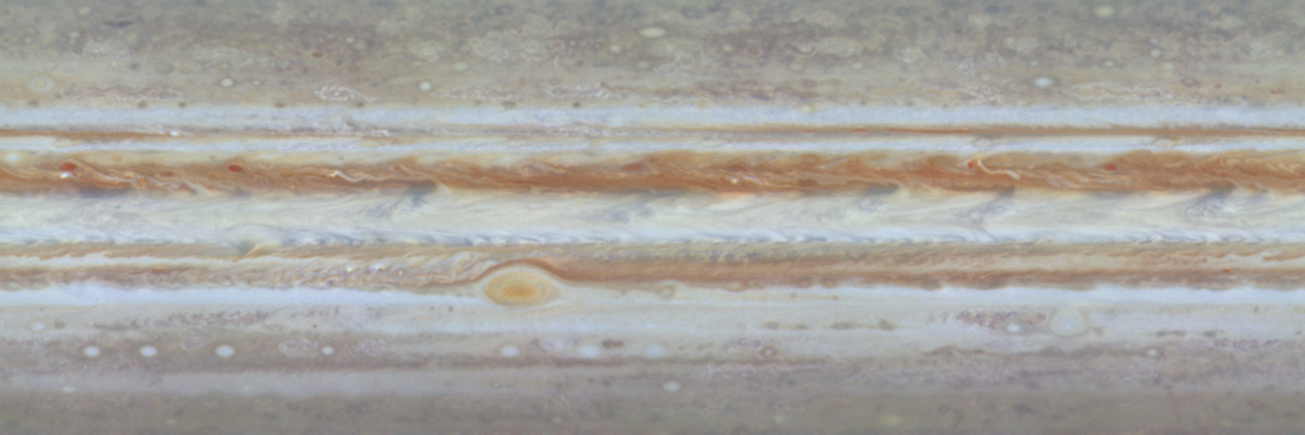
Jupiter
JPL/NASA
Notes:
1 year timelapse of 60 deg north to south. Shadows and satellites of Jupiter visible.

Slide 30
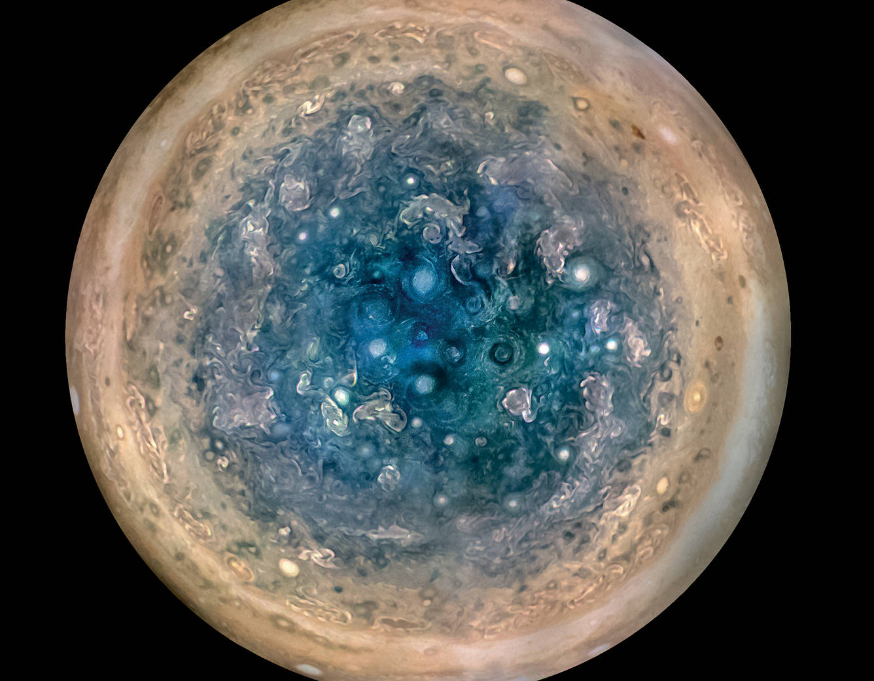
Jupiter
NASA/JPL-Caltech/SwRI/MSSS/
Betsy Asher Hall/Gervasio Robles
Notes:
Juno Orbiter image of South pole’s cyclones up to 1000 KM in diameter (~top Scotland John O’groats to Brighton) Enhanced Colour

Slide 31
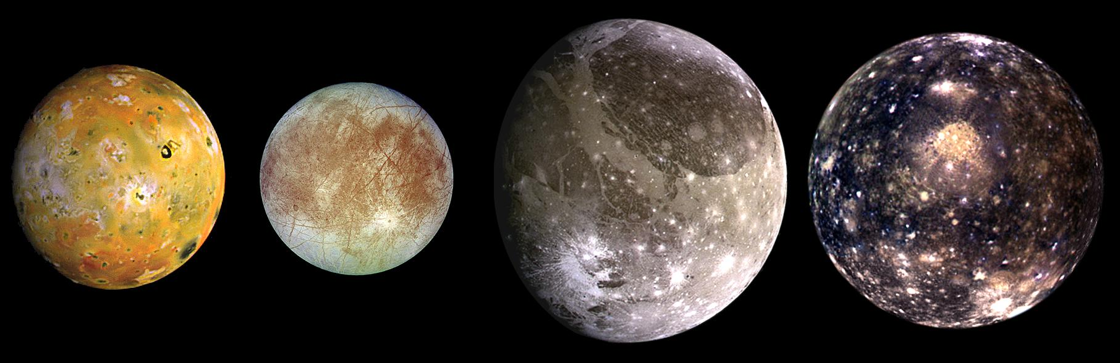
Jupiter’s Moons
JPL/NASA
Notes:
Io Galileo Europa Ganymede – Bigger than any dwarf planet Callisto

Slide 32
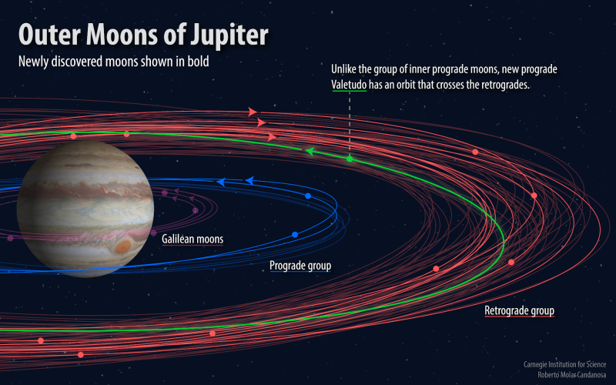
Jupiter’s Moons
JPL/NASA
Notes:
79 total 11 with DECAM (Dark Energy Camera from the DES survey) https://carnegiescience.edu/news/dozen-new-moons-jupiter-discovered-including-one-%E2%80%9Coddball%E2%80%9D

Slide 33
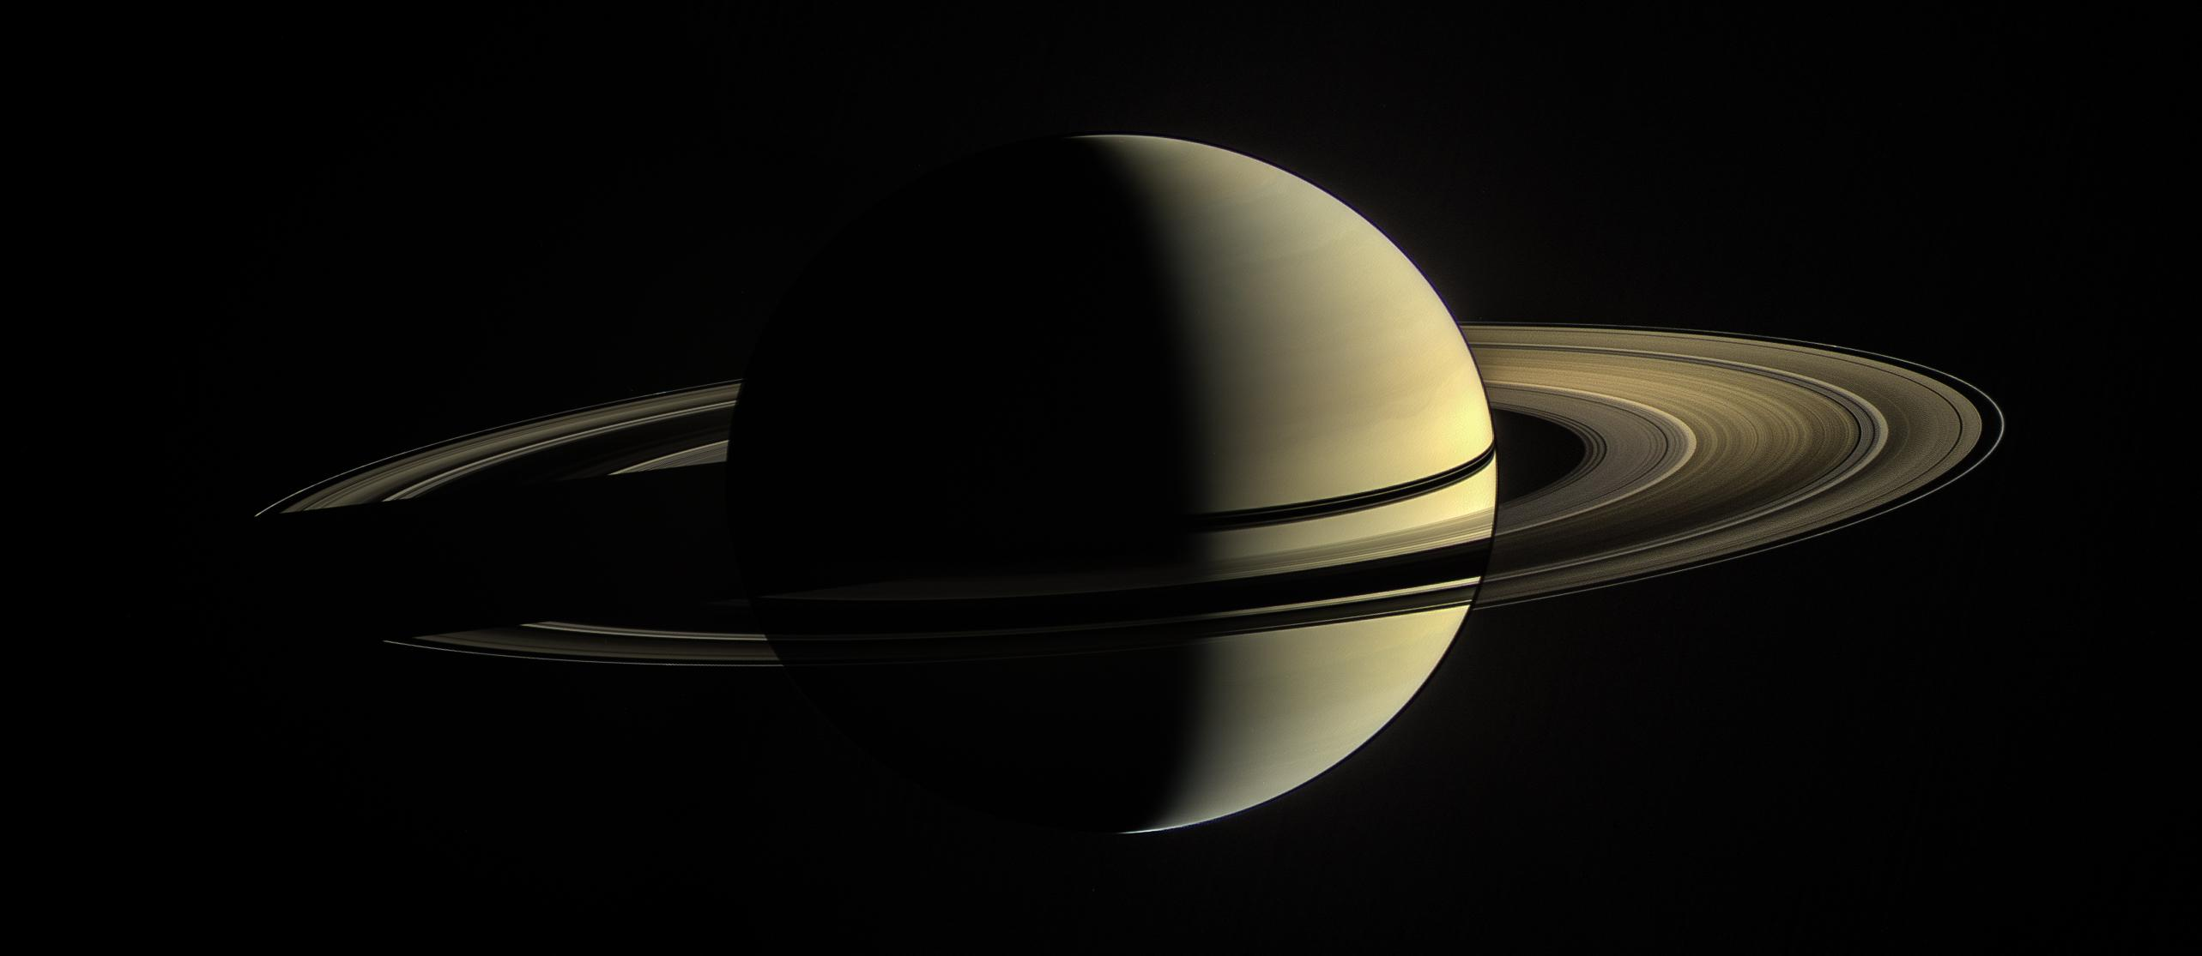
Saturn
JPL/NASA
Notes:
Cassini Comp. with Europa shadow

Slide 34
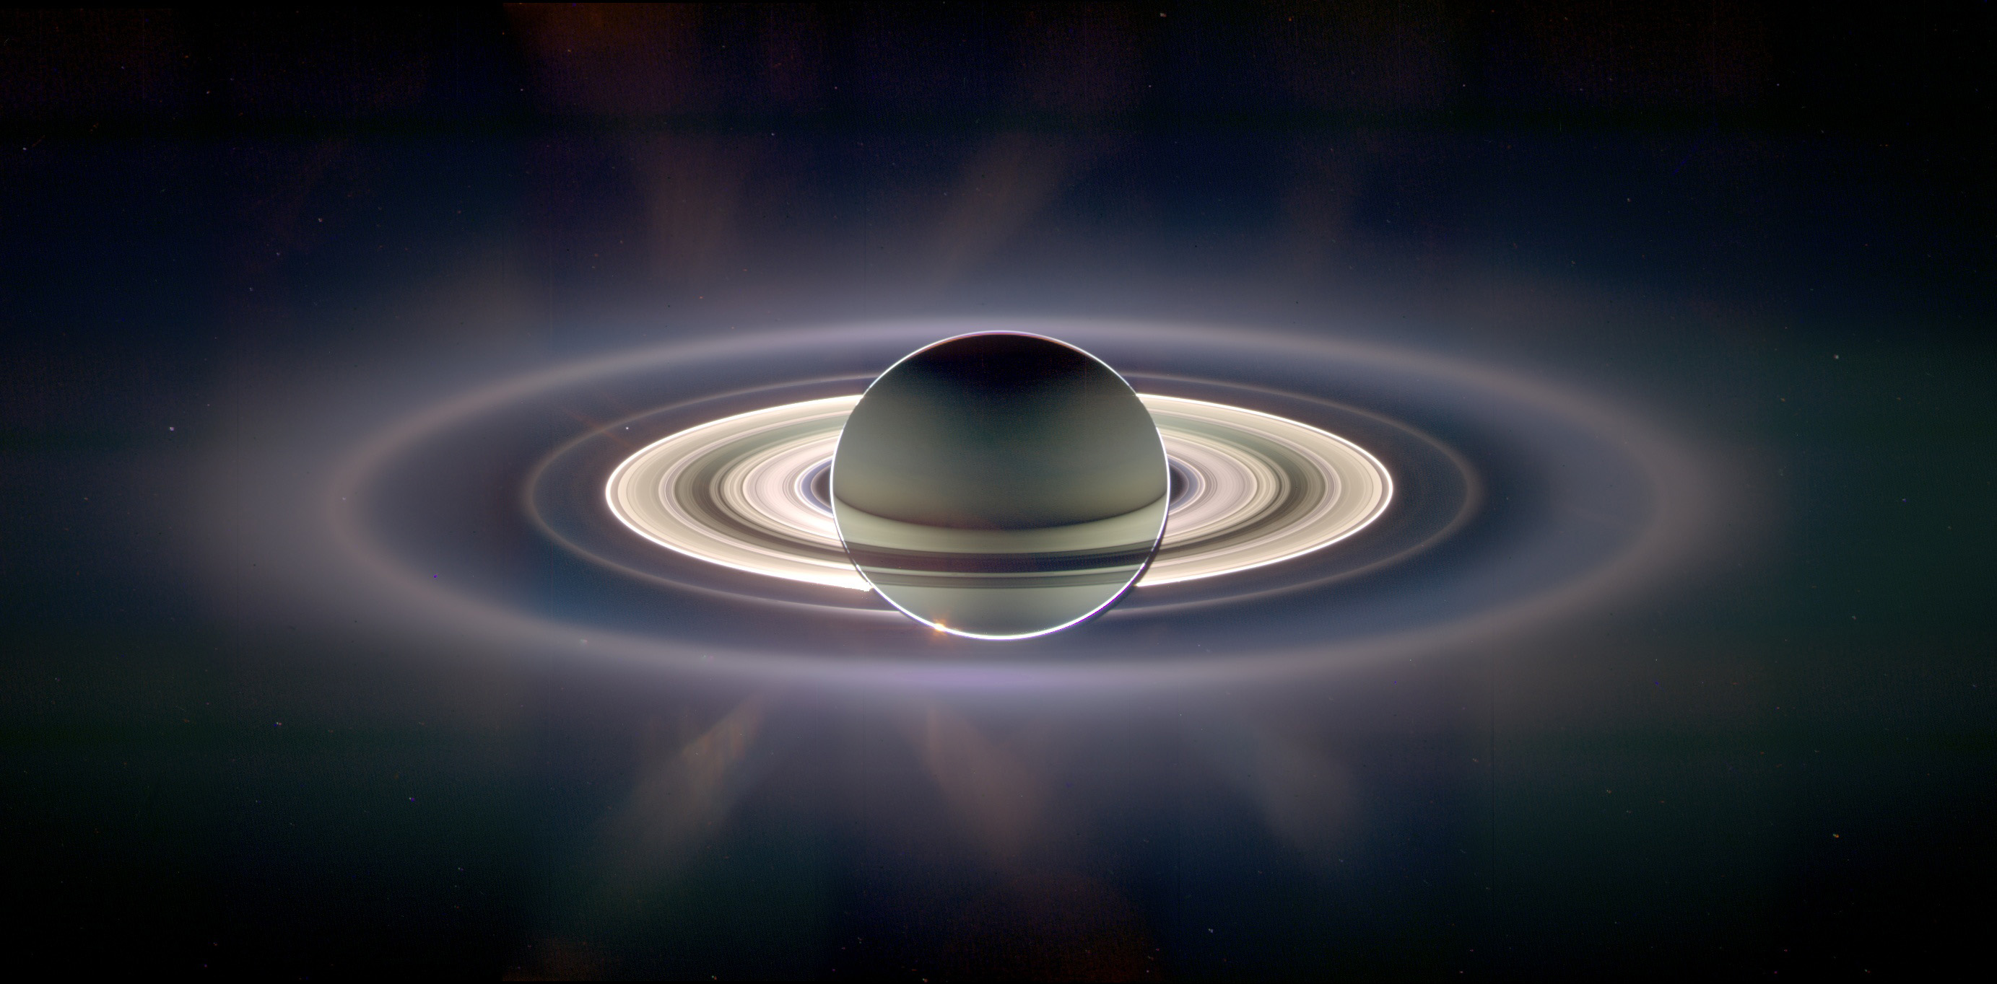
Saturn
JPL/NASA
Notes:
Cassini Comp. enhanced colour to reveal new rings and differences in composition.

Slide 35
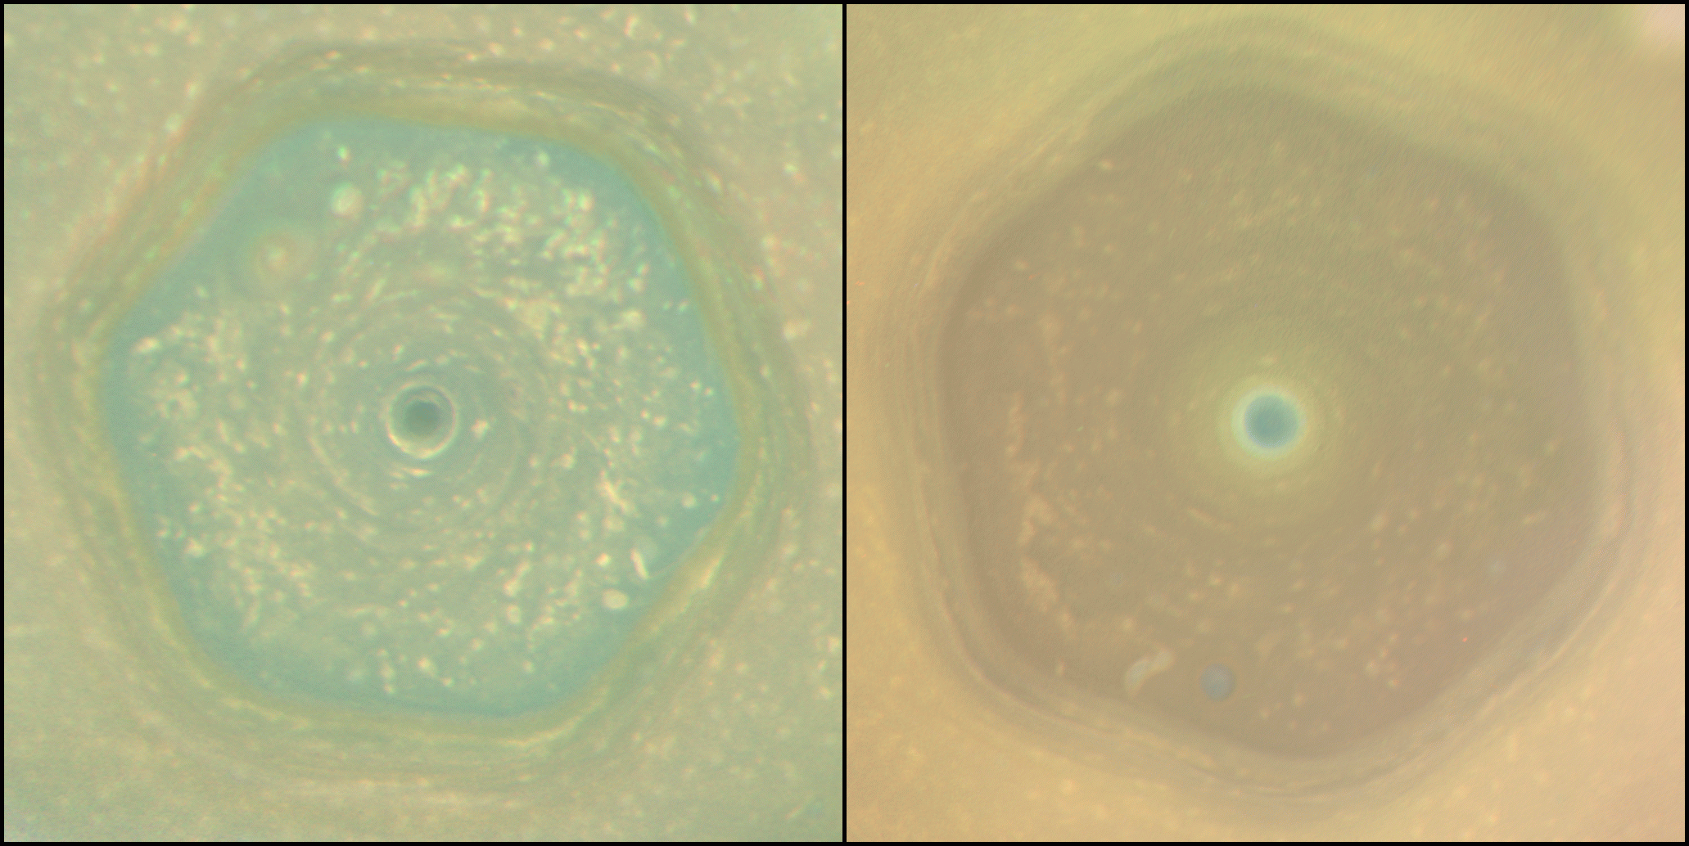
JPL/NASA
Notes:
Have form from early 2010s to 2017 due to change in tilt more UV exposure create red haze organic chemicals

Slide 36
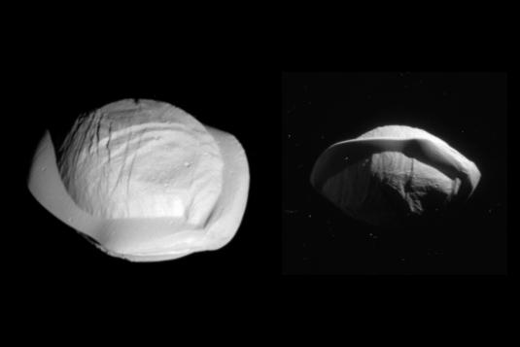
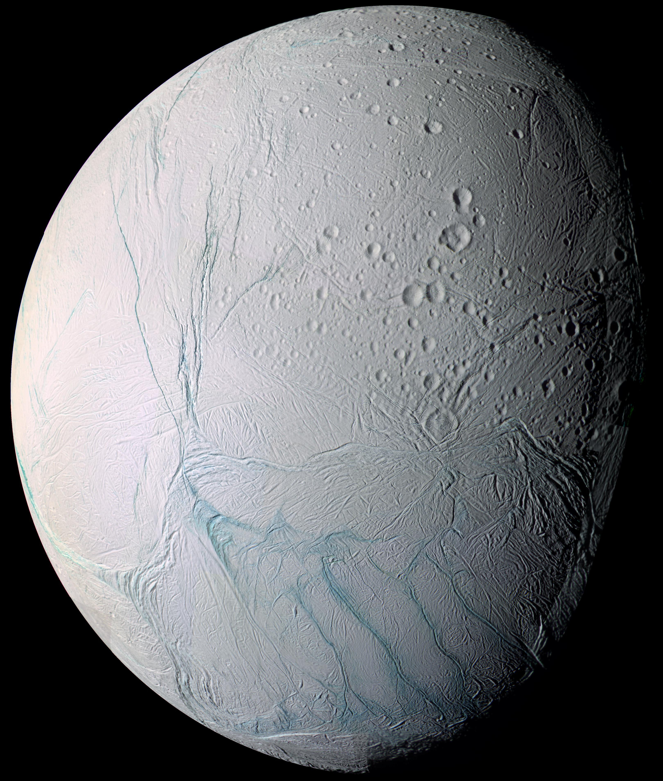
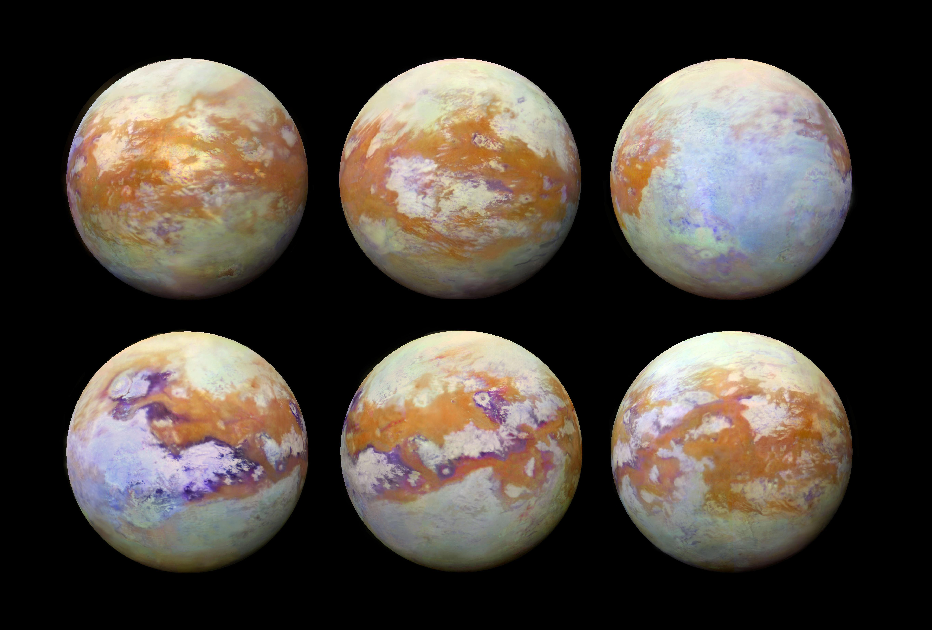
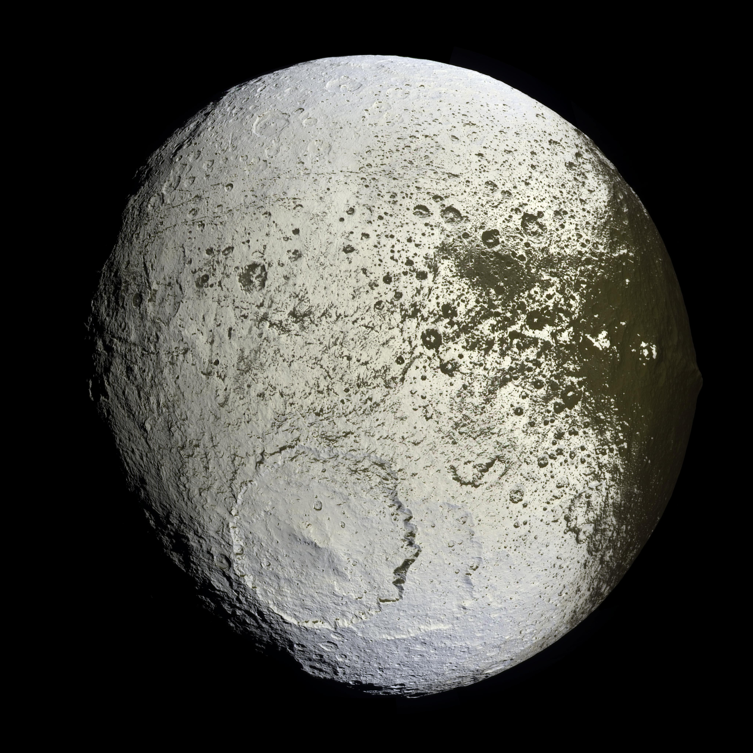
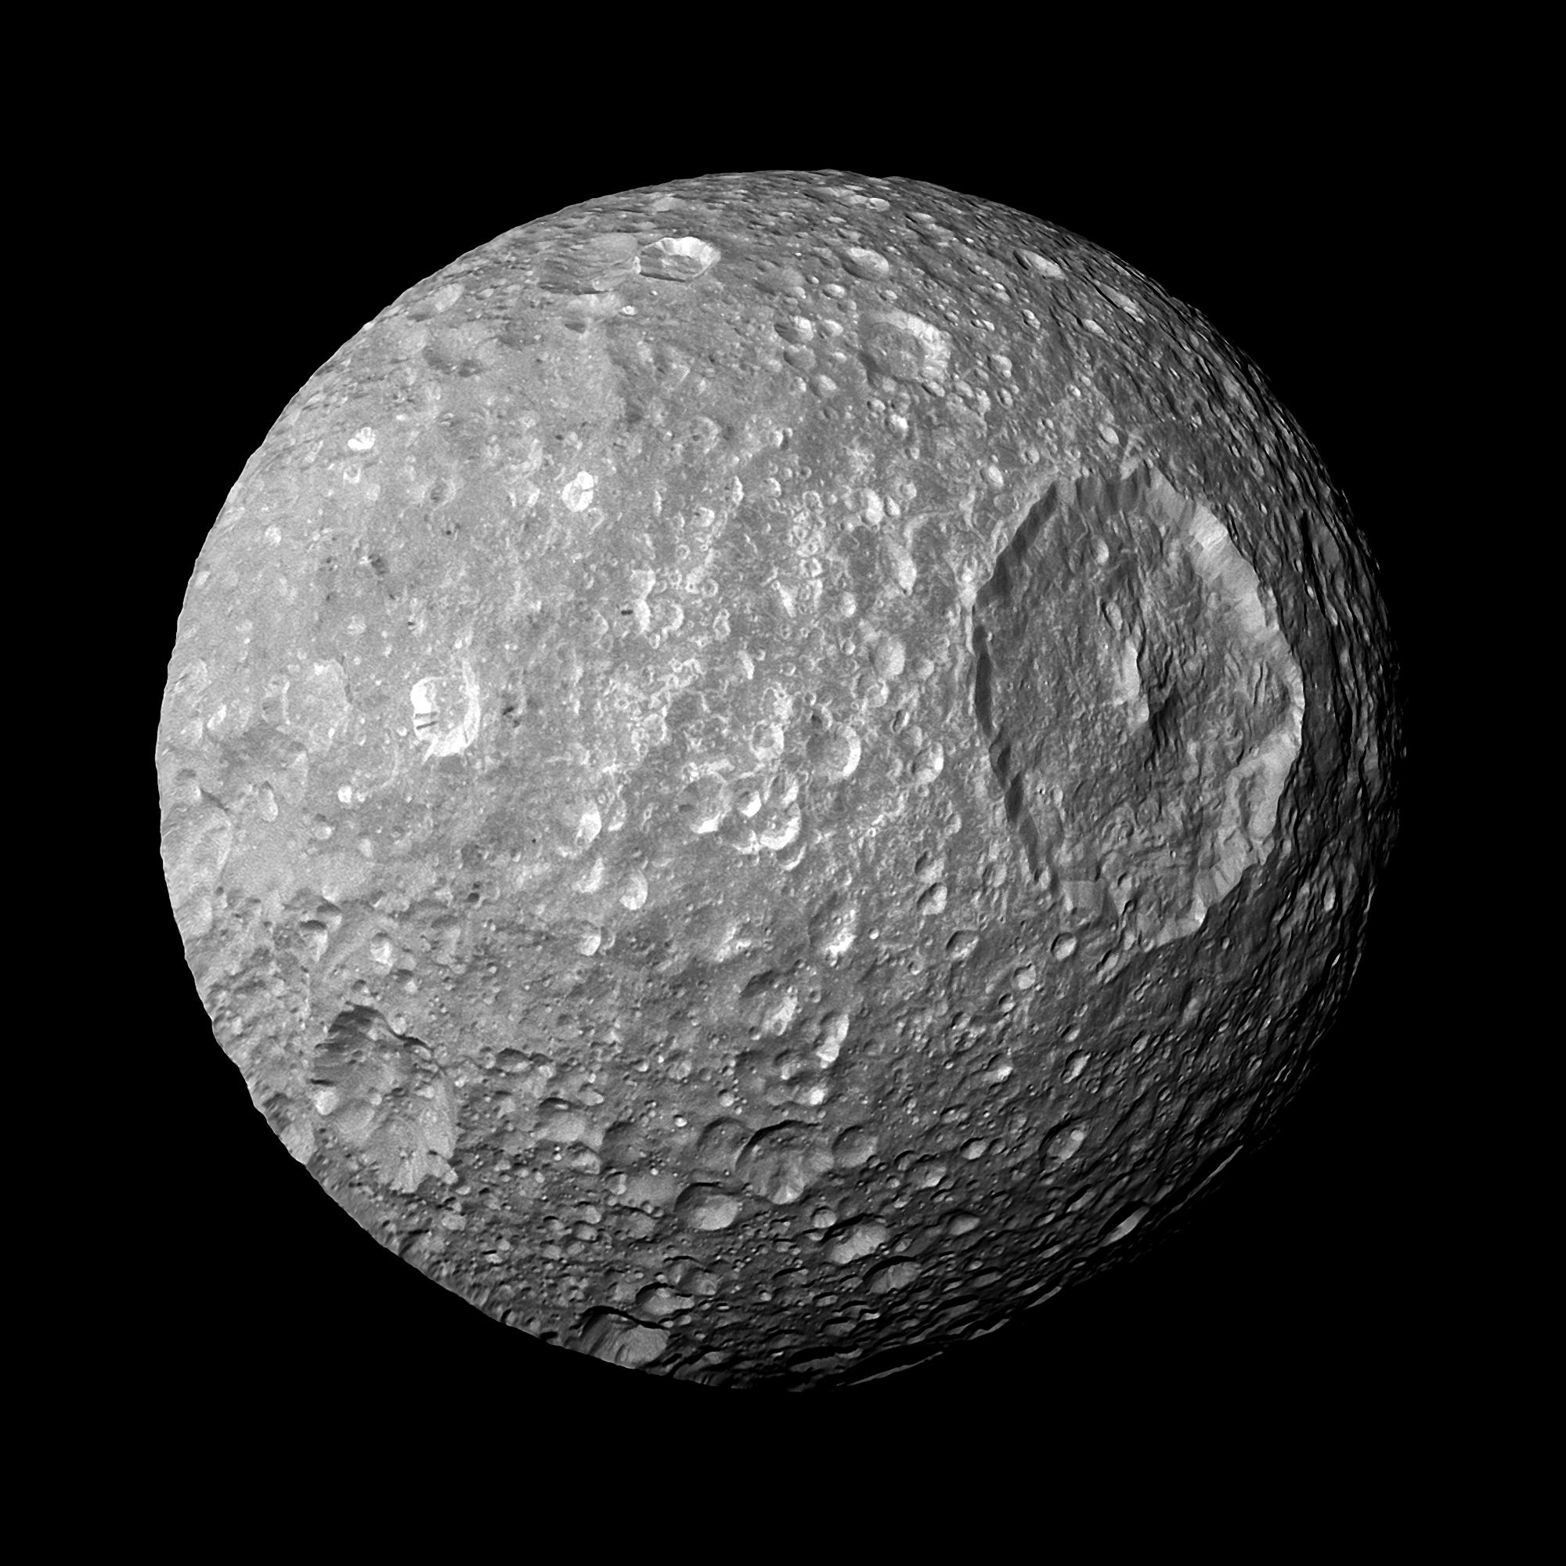
Saturn’s Moons
Pan
Titan
Mimas
Enceladus
Iapetus
JPL/NASA

Slide 37
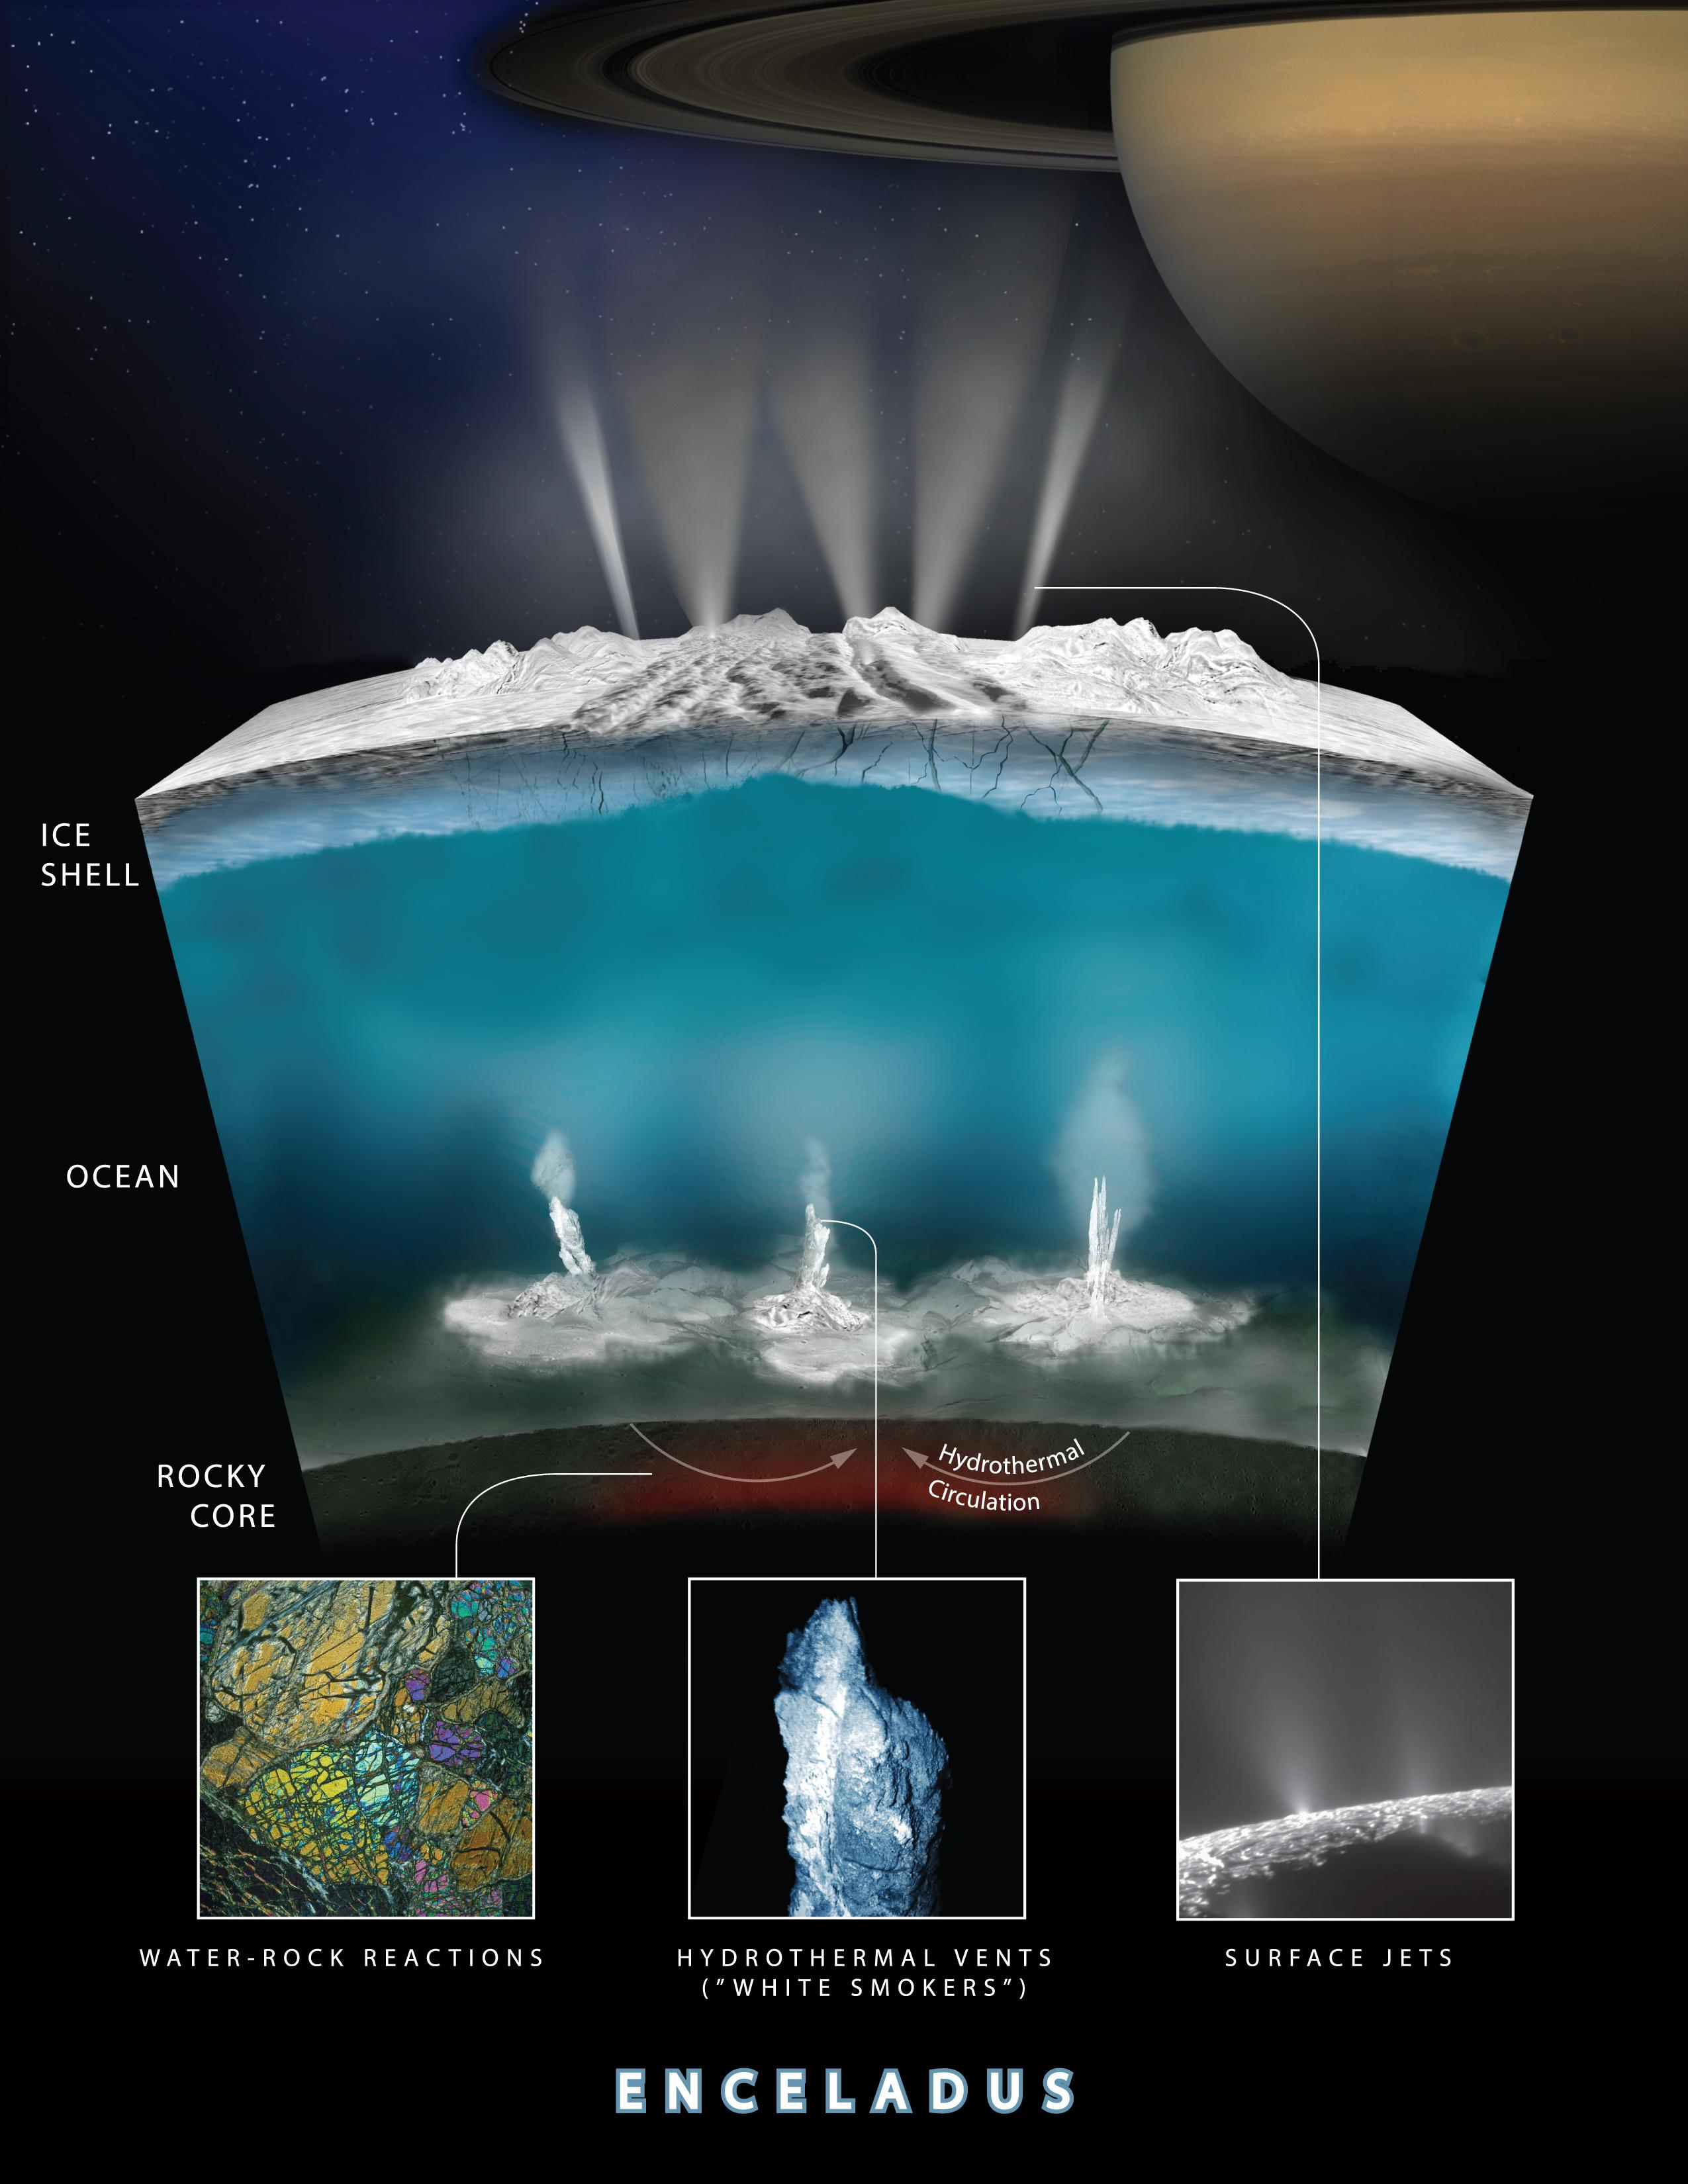
Saturn/ Enceladus
JPL/NASA
Notes:
Life in subsurface ocean

Slide 38
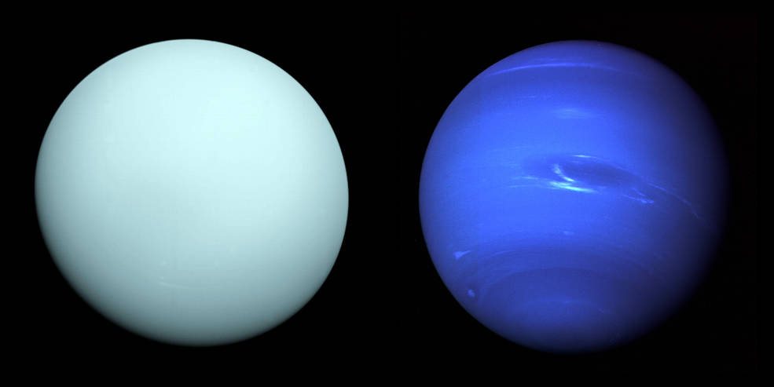
The Ice Giants

Slide 39
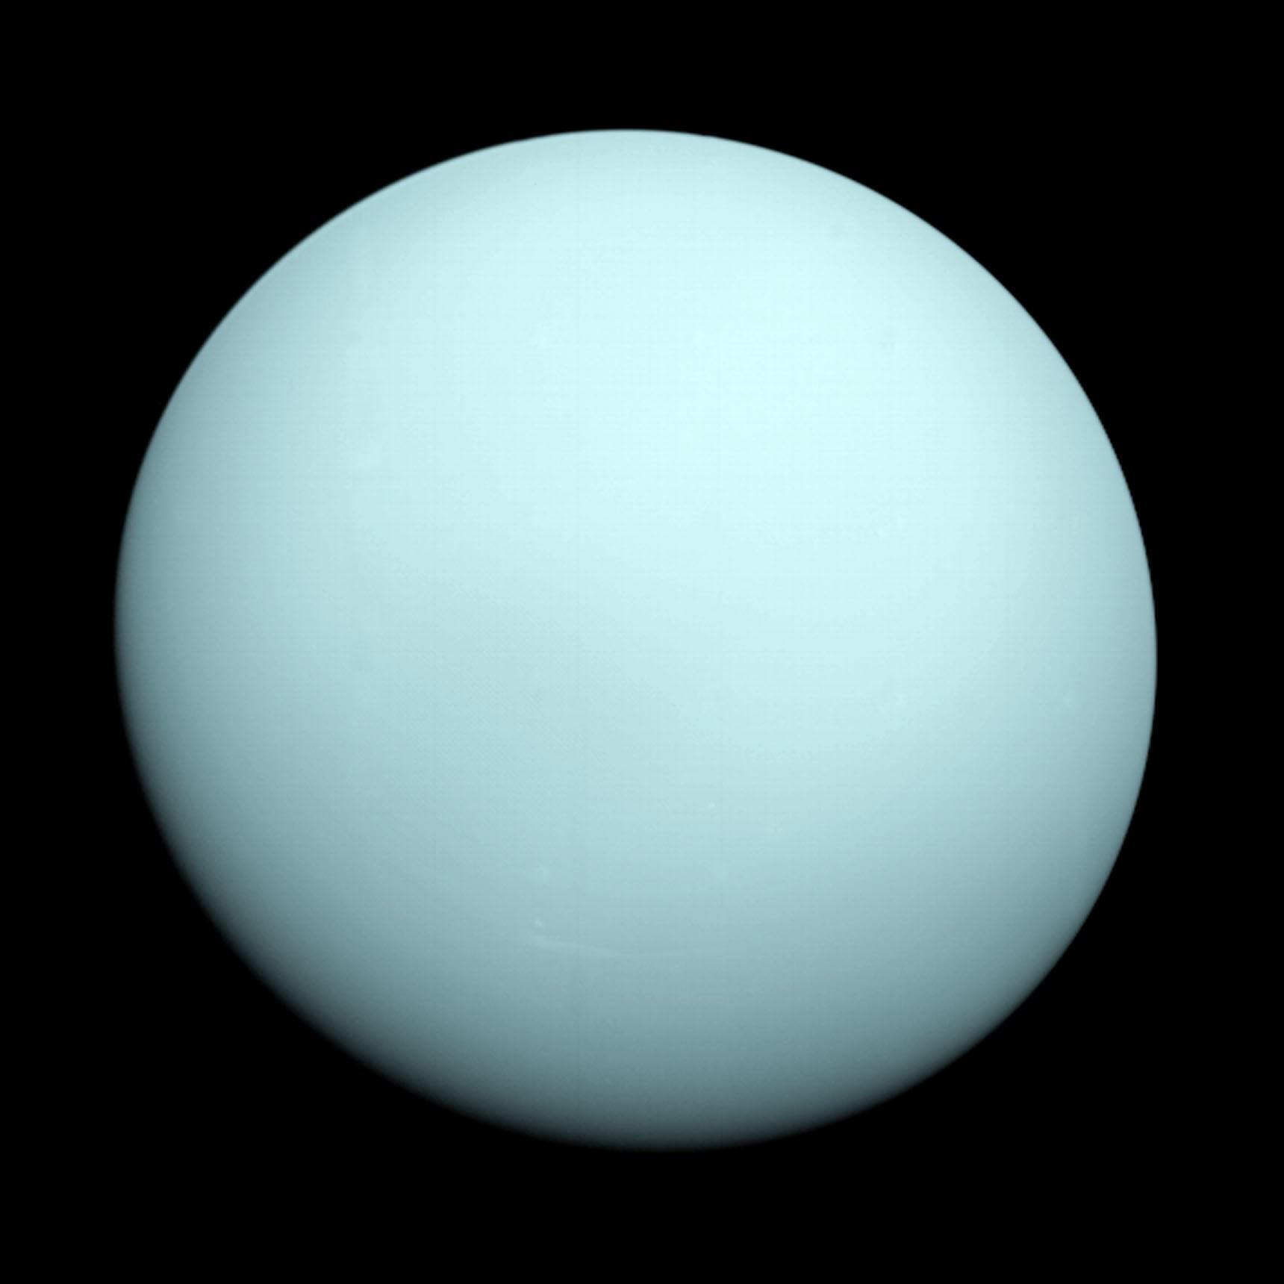
Uranus
JPL/NASA
Notes:
Only visited by voyager 2 – ICE GIANT Ices suggest that water/brine ocean conducts elec and causes mag field Rotates on its side? No idea why cant be impact – moons orbit the same

Slide 40
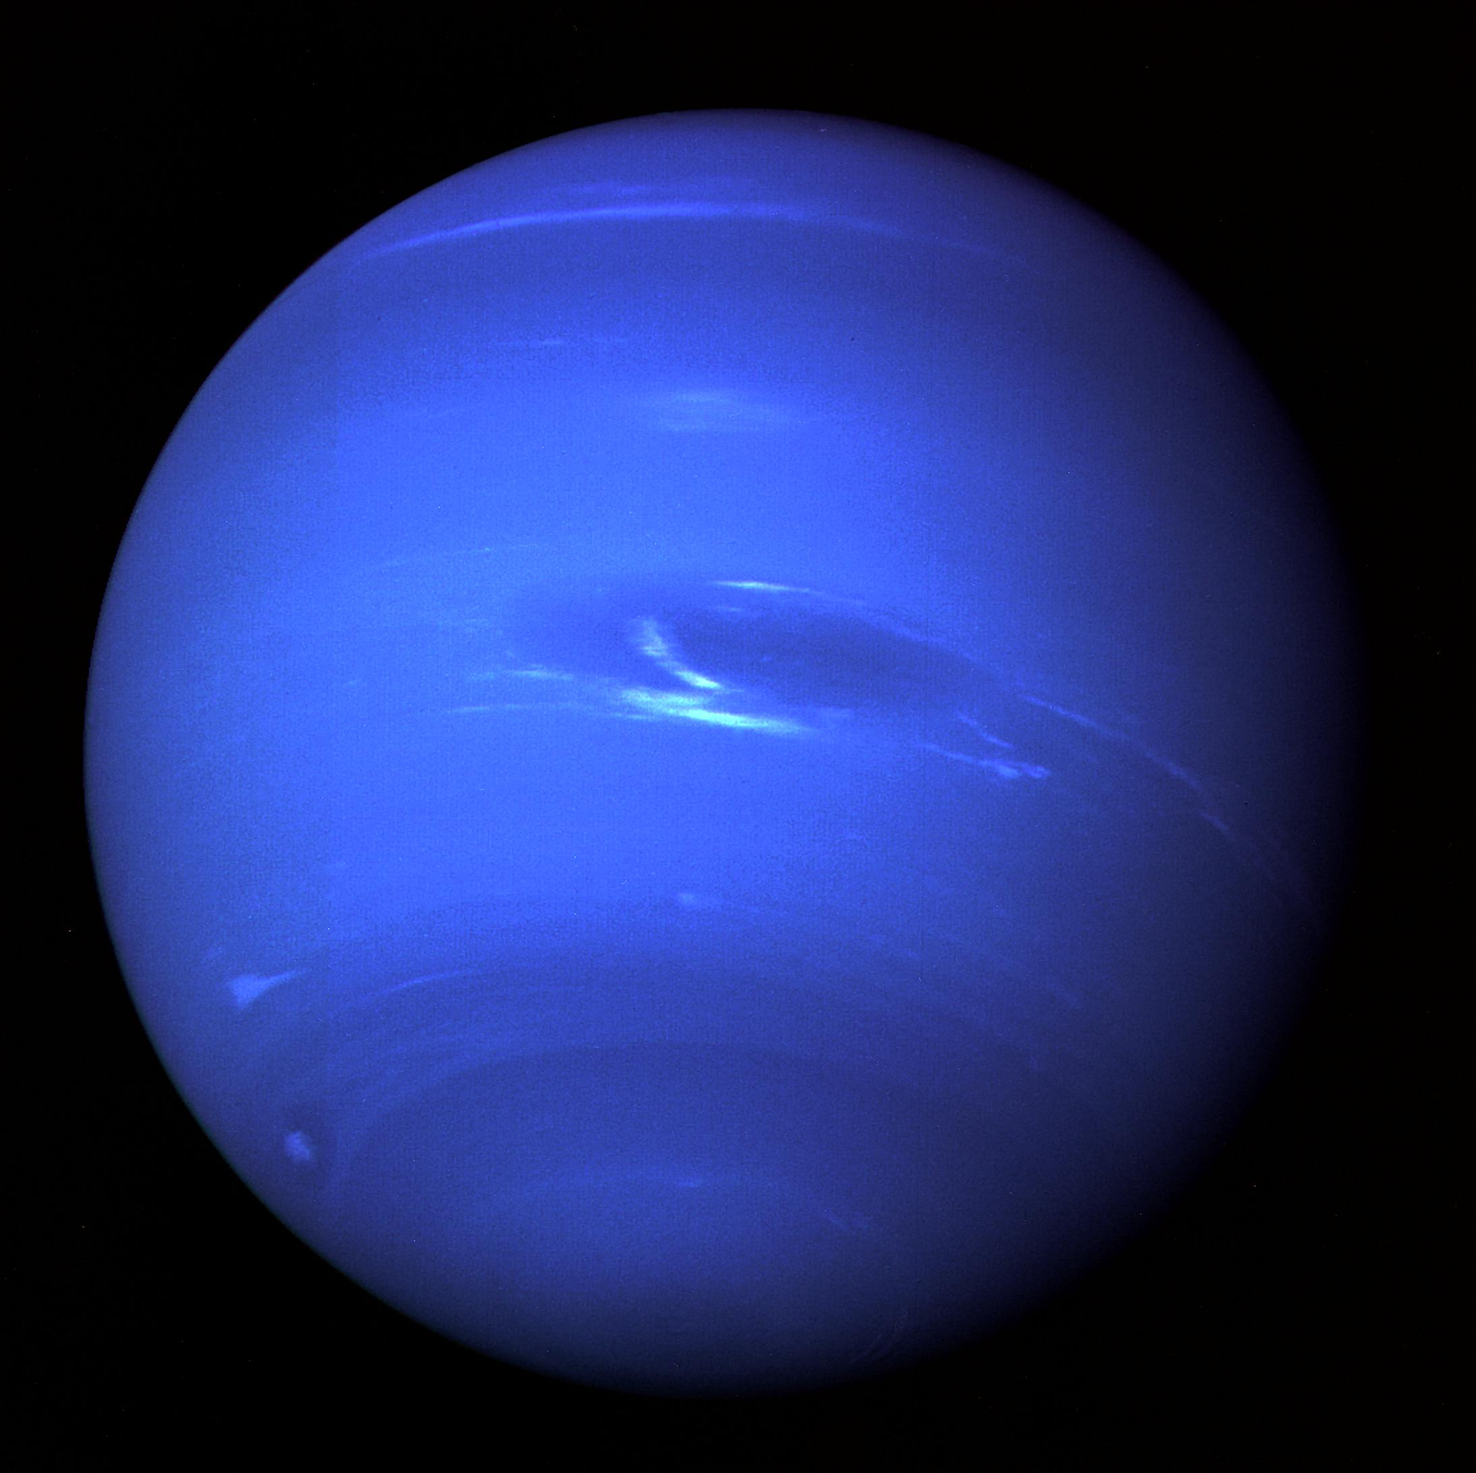
Neptune
JPL/NASA
Notes:
Only visited by voyager 2

Slide 41
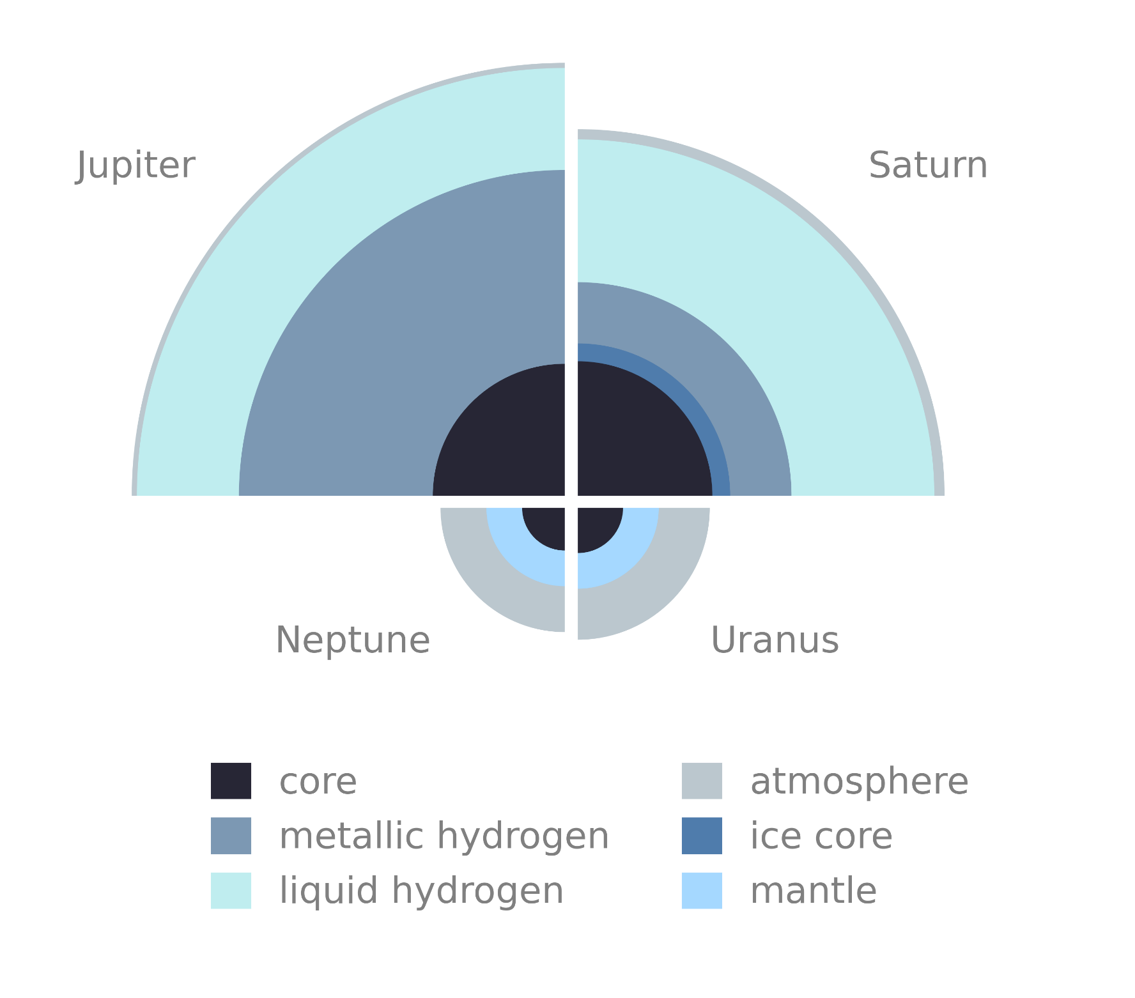

Slide 42
Quick Quiz
What gases are the Gas Giants made out of?
Do the gas giants have a solid surface?
Which gas giants have rings?

Slide 43
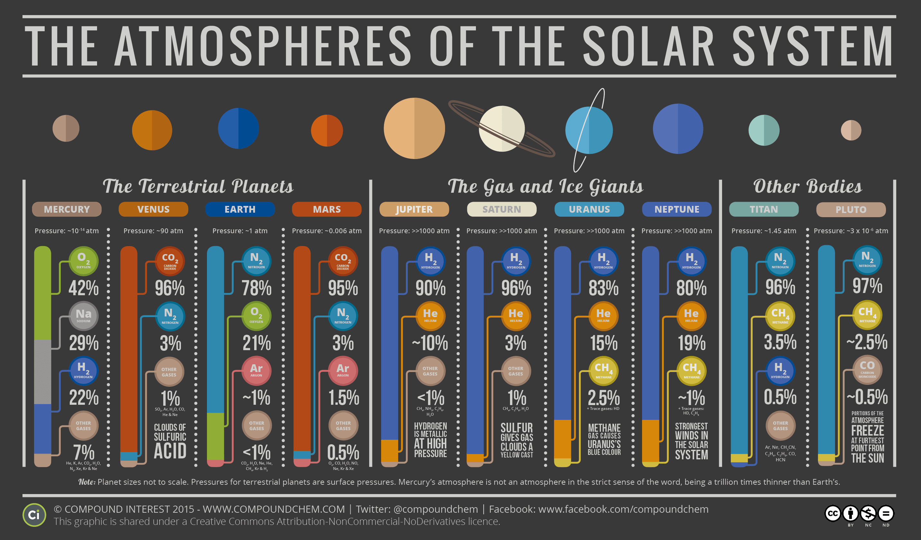

Slide 44
Planetary Surfaces
Up next:

